Slide 1
Making Sense of Climate Research
G-WOW Changing Climate Changing Culture Institute
Brian G. Zimmerman
University of Wisconsin – Madison
bgzimmerman@wisc.edu

Slide 2
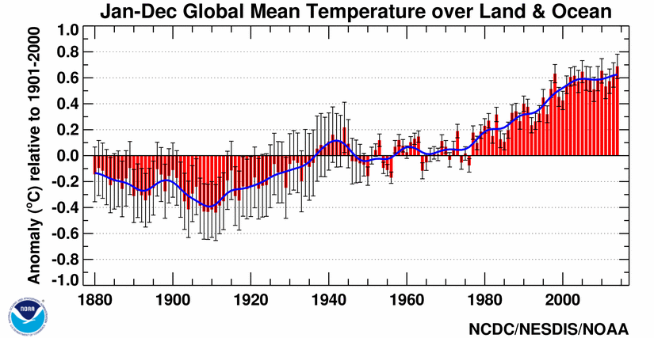
Global temperature is increasing
Three things we know about climate change…
Global temperature has warmed by about 1°C since 1900
http://www.ncdc.noaa.gov/sotc/summary-info/global/201412

Slide 3
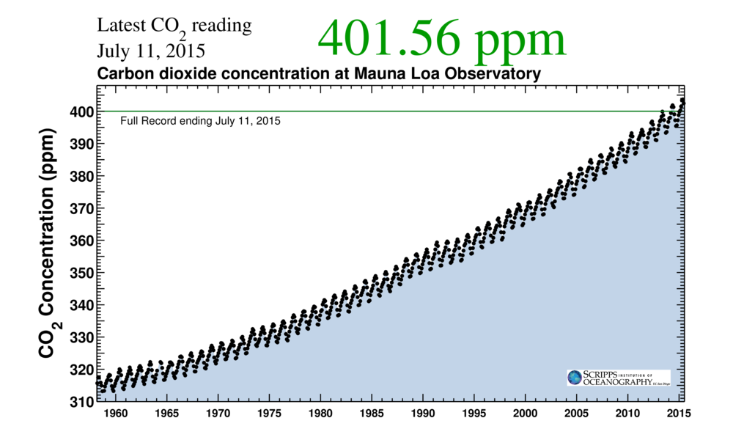
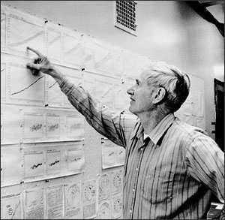
Carbon dioxide concen-tration is increasing due to human activity
Three things we know about climate change…
Carbon isotope ratios confirm fossil fuel origin
Annual variations due to biosphere “breathing”
https://scripps.ucsd.edu/programs/keelingcurve/

Slide 4
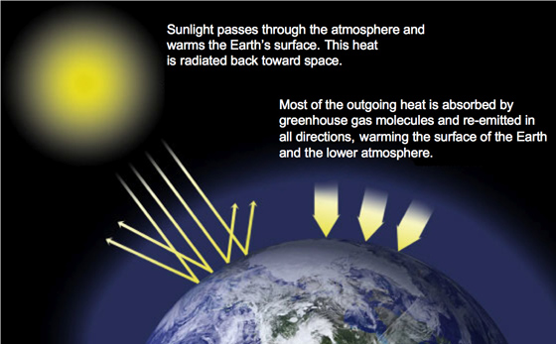
Carbon dioxide and other greenhouse gasses warm our planet
Three things we know about climate change…
The “Greenhouse Effect” warms Earth by ~18°C
Human emissions are en-hancing Earth’s natural greenhouse effect
http://climate.nasa.gov/causes/

Slide 5
Some of the infrared
radiation passes
through the atmosphere
but most is absorbed
and re-emitted in all
directions by greenhouse
gas molecules and clouds.
The effect of this is to
warm the Earth’s surface
and the lower atmosphere
(IPCC AR4 WG1).
Greenhouse
Effect
Sun = hot = emits shortwave (UV) radiation
Shortwave
Longwave
Greenhouse gases
Earth = cool = emits longwave (IR) radiation
Wien’s Law: Wavelength inversely related to temperature

Slide 6
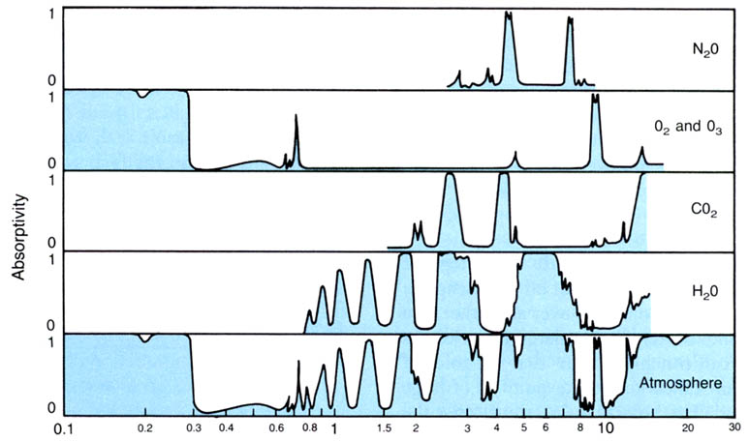
Absorption Spectrum: Amount of Radiation Absorbed at a Given Wavelength
ULTRAVIOLET
(Shortwave)
INFRARED
(Longwave)
VISIBLE
Not absorbed
Not absorbed
Absorbed
Greenhouse gases primarily absorb longwave (infrared) radiation
Fleagle & Businger

Slide 7
It is extremely likely that human influence has been the dominant cause of the observed warming since the mid-20th century.
IPCC AR5 WGI SPM and 10.3–10.6, 10.9

Slide 8
Model simulations reproduce the 20th century observed warming
Are the models any good?
Models forced with an-thropogenic and natural forcing reproduce ob-served warming
Models with only natural forcing do not
IPCC AR5 WGI Fig. 10.1

Slide 9
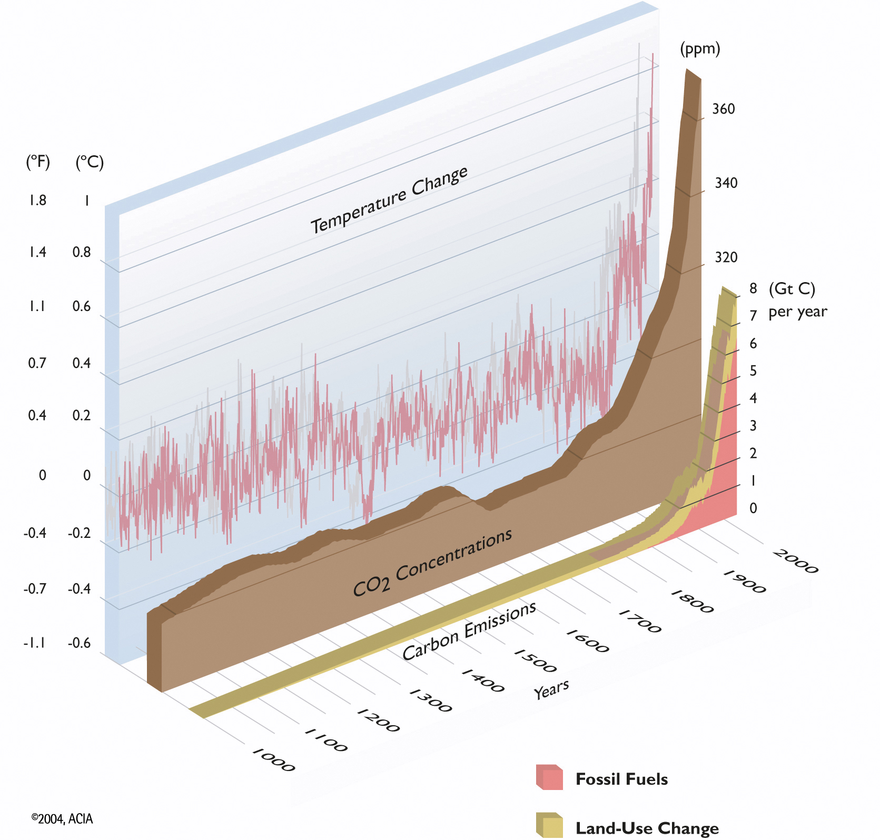
Northern Hemispheric Temperature, Carbon Dioxide, and Carbon Emissions
The recent
decades
have been
the warmest
in the last
1000 years
1000-1860: Climate Reconstruction
(tree rings, corals, ice cores, historical records)
1860-present: Instrumental records
Arctic
Climate
Impact
Assessment

Slide 10
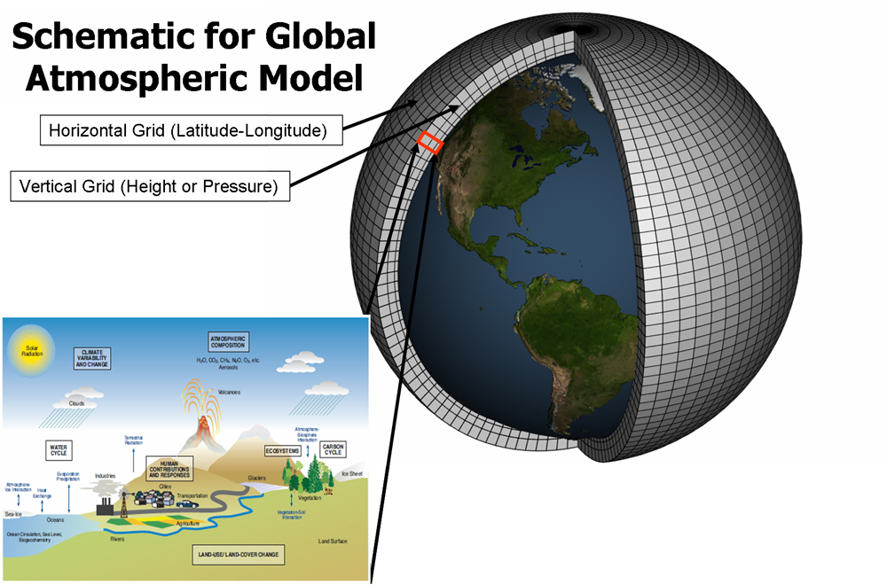
Climate models are forced by observed or expected forcings
How do we quantify climate change?
Models include atmo-sphere, ocean, land, cryosphere, biosphere
http://climate.nasa.gov/causes/

Slide 11
Global Climate Change
Future Global Temperature: Global temperature will rise an additional 1°-1.5°C (~2°F) by 2050, 1°-4°C (1.5°-7°F) by 2100.
6
°C Warming
4
2
0
-2
1900
2000
2100
Notes:
Recall – the amount of temperature change is independent of scenario by ~2050 – we need to adapt to that much climate change. But, we want to mitigate so we’re on a “good” scenario rather than a “dangerous” scenario. Both adaptation and mitigation are needed.

Slide 12
Global Climate Change
Future Global Temperature: Global temperature will rise an additional 1°-1.5°C (~2°F) by 2050, 1°-4°C (1.5°-7°F) by 2100.
6
Mitigation:
Steps to avoid dangerous levels of climate change
°C Warming
4
2
0
-2
1900
2000
2100
Notes:
Recall – the amount of temperature change is independent of scenario by ~2050 – we need to adapt to that much climate change. But, we want to mitigate so we’re on a “good” scenario rather than a “dangerous” scenario. Both adaptation and mitigation are needed.

Slide 13
Global Climate Change
Future Global Temperature: Global temperature will rise an additional 1°-1.5°C (~2°F) by 2050, 1°-4°C (1.5°-7°F) by 2100.
6
Mitigation:
Steps to avoid dangerous levels of climate change
Adaptation:
Some climate change is inevitable; Adaptation needed to minimize impacts
°C Warming
4
2
0
-2
1900
2000
2100
Notes:
Recall – the amount of temperature change is independent of scenario by ~2050 – we need to adapt to that much climate change. But, we want to mitigate so we’re on a “good” scenario rather than a “dangerous” scenario. Both adaptation and mitigation are needed.

Slide 14
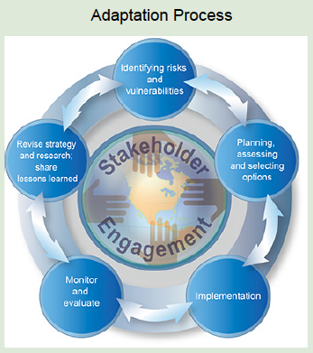
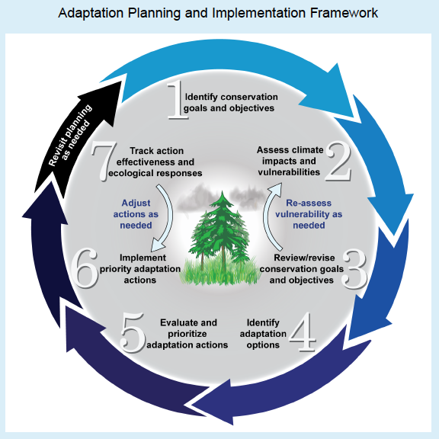
“Adaptation to climate change is the adjustment in natural or human systems in response to actual or expected climatic stimuli or their effects, which moderates harm or exploits beneficial opportunities.” – IPCC 2008
WICCI 2011; National Climate Assessment; IPCC 2008; NRC 2010; NWF 2013

Slide 15
Climate Feedbacks
“Differences in feedbacks contribute almost three times more to the range in equilibrium climate sensitivity estimates than differences in the models’ radiative forcings”
- IPCC AR4

Slide 16
Forcings vs. Feedbacks?

Slide 17
What is a forcing?
A forcing drives a change in the climate state
A forcing is EXTERNAL to the system of interest

Slide 18
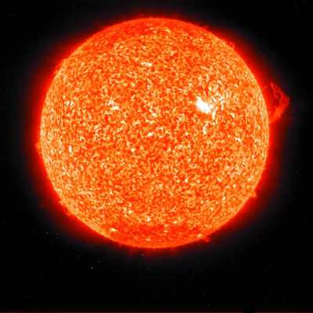
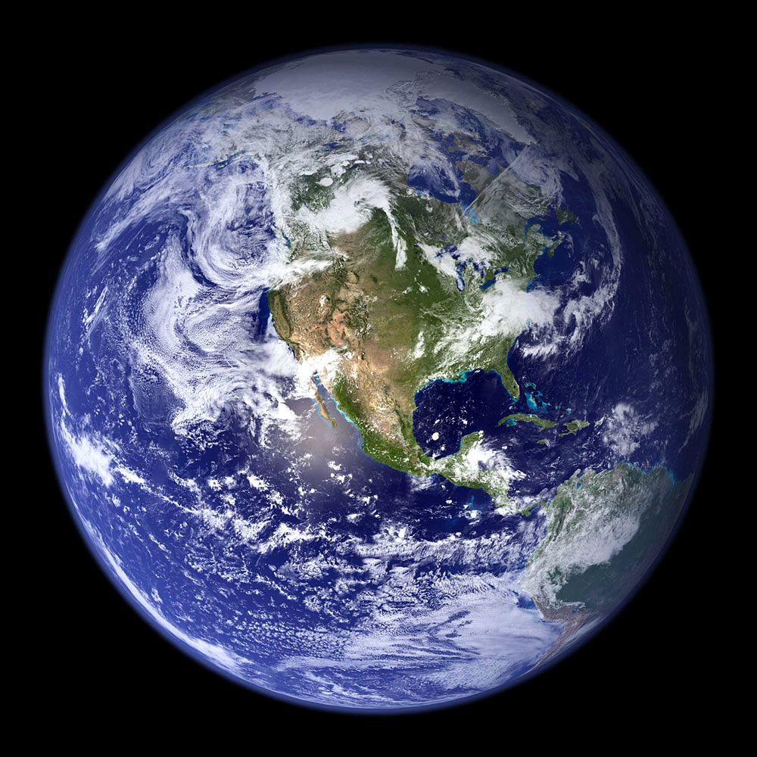
Forcings
Examples for Earth System
Change in the solar constant
Change in Earth’s orbit around the Sun
What are some examples in the climate (considering atmosphere/ocean as an isolated system)?
Notes:
Anthropogenic CO₂ might be an example and aerosols – both can be introduced through human activities.
Also clouds.
But all of these parameters can also RESPOND to changes in the climate and thus serve as feedbacks also!

Slide 19
What is a feedback?
A feedback is an internal response in the climate system that modifies the impact of the initial forcing
Moderating influence = negative feedback
Enhances influence = positive feedback
We usually think of feedbacks as ‘loops’
Notes:
So what is your definition of a feedback? The formal definition goes like this…
Can you think of examples of positive and negative feedbacks? How about ones not related to climate? What if I put a speaker and an amplifier next to each other? What does your body do to cool off when you exercise?
Key here is that positive feedbacks perturb the system in the same direction as the original forcing while negative feedbacks tend to counter-act the forcing and return the system back to its original state.
19

Slide 20
Negative Feedback
Increased Earth temperature implies increase in emitted energy.
This increased emission will somewhat offset the increased greenhouse effects of CO₂.
Increased CO₂ Concentrations
Initial Climate Warming
Warmer Temps.
Increased
Emission to Space
Reduced Warming
Response Muted
Notes:
There are numerous other factors in the climate system that respond to warming and many of these factors can, in turn, impact the global energy balance themselves. I want to spend a little bit of time reviewing two feedbacks that you may have already covered and put them in the context of our simple model of the climate system because both are closely related to similar processes involving clouds. One fairly obvious feedback that occurs in our climate system comes from the Stefan-Boltzmann law itself. Increasing the temperature of a blackbody causes it to radiate away more energy, in turn cooling it down. We can even work out the magnitude of this feedback mathematically by taking the derivative of the S-B law. A 1K increase in temperature leads to a ** K/day cooling response due to the S-B law.

Slide 21
Positive Feedback
Increasing temperatures cause glaciers and ice sheets to melt.
Less sunlight is reflected back to space allowing more energy to be absorbed in the atmosphere and surface further enhancing the warming effects of CO₂.
Increased CO₂ Concentrations
Initial Climate Warming
Melting of Glaciers and Ice Sheets
Less Solar Radiation Reflected
Increased Warming
Response Amplified
Notes:
But the negative feedbacks are not really the ones we’re worried about. They act like a spring restoring the system back toward its original equilibrium. Positive feedbacks on the other hand occur when the initial change leads to the system responding in a way that amplifies the change. As we discussed when we talked about stability, this drives the system further away from equilibrium and creates an unstable state. One fairly well-understood example of this is the melting of snow and sea ice on the planet…
An example of a well-understood positive feedback mechanism is that due to increased water vapor in the atmosphere. More evaporation can be expected from warmer oceans and a warmer atmosphere can hold more water vapor. As a result, we can expect significant increases in water vapor in a global warming scenario and, much like CO2, water vapor acts to make the atmosphere more opaque, increasing the height where the Earth’s emission comes from. This once again creates a situation where the Earth emits less energy than it receives from the sun, this time because the emitting temperature goes down. The result is a substantial increase in warming that models actually predict may be up to twice as strong as that due to CO2 itself. This brings up another important point – unlike negative feedbacks that tend to bring the system back toward equilibrium, positive feedbacks are far more dangerous since they have the potential to create a runaway scenario in which the planet keeps getting warmer and warmer with little to limit it.

Slide 22
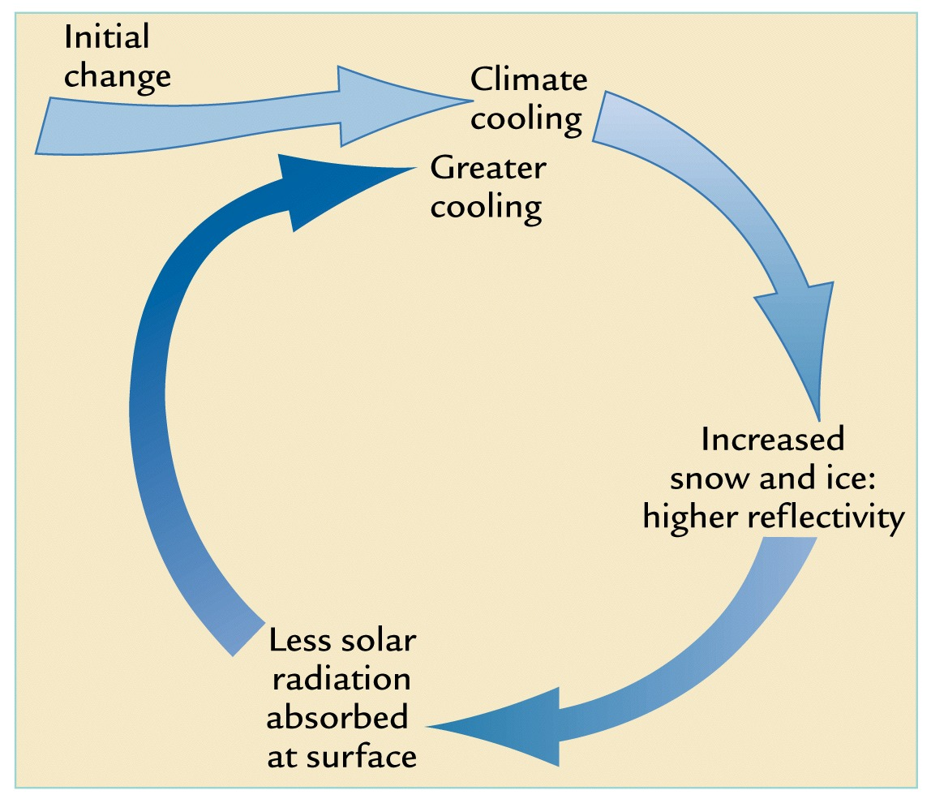
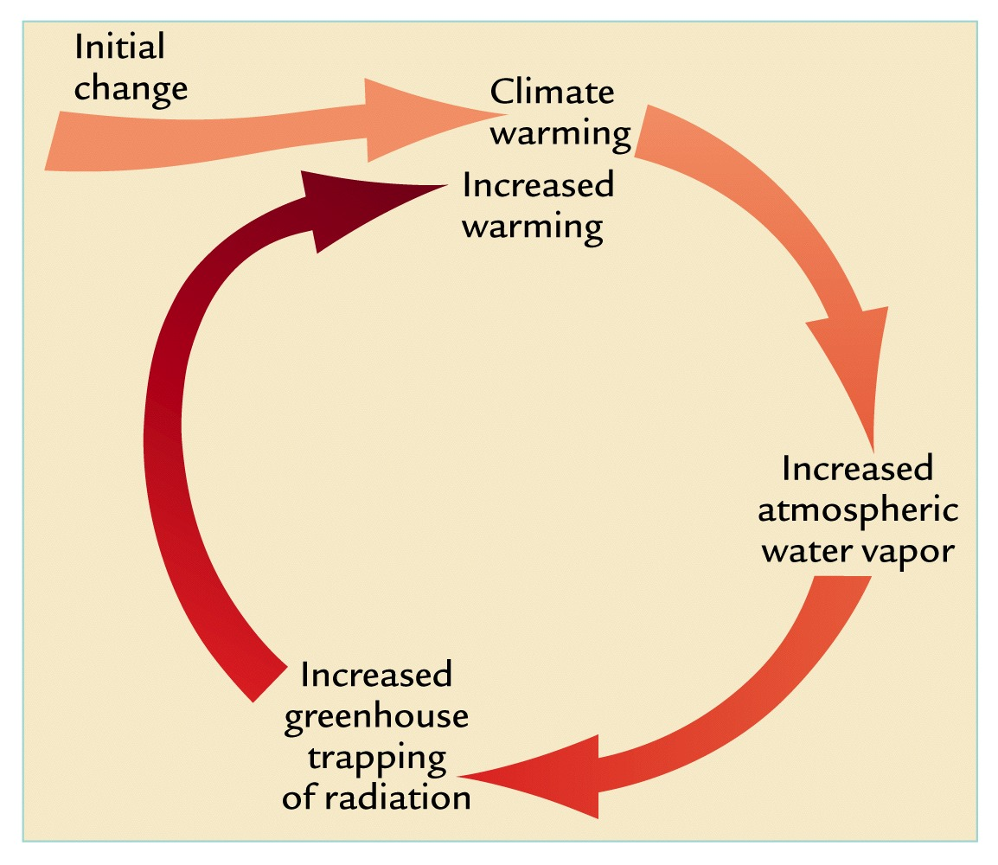
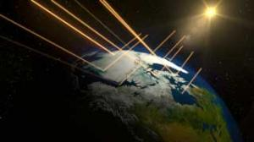
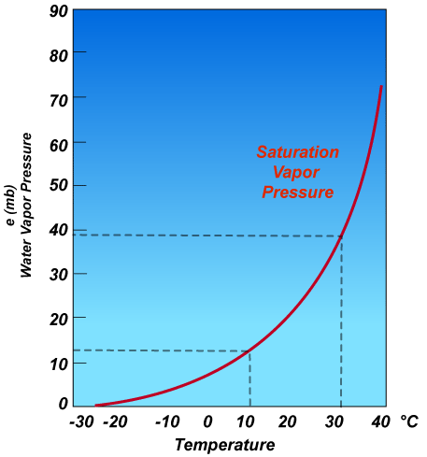
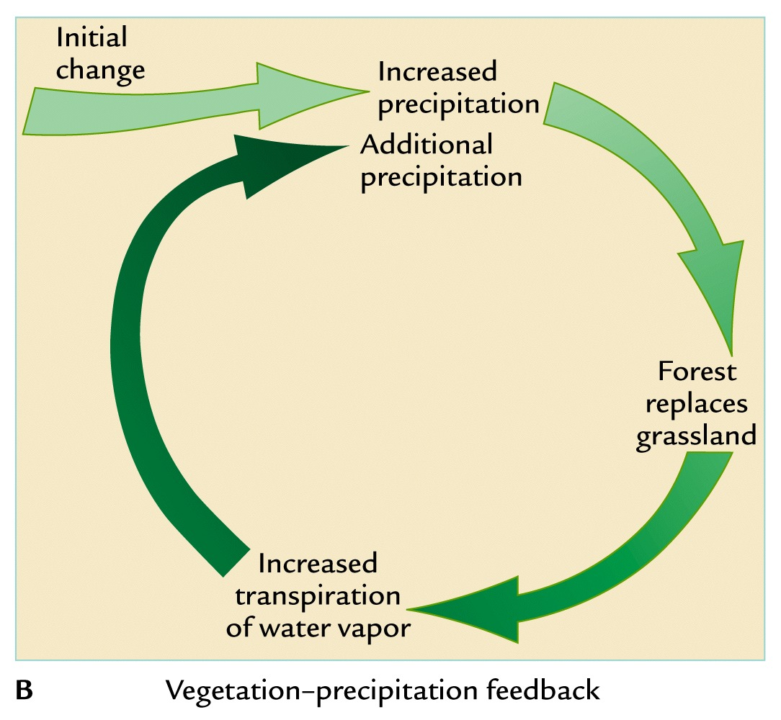
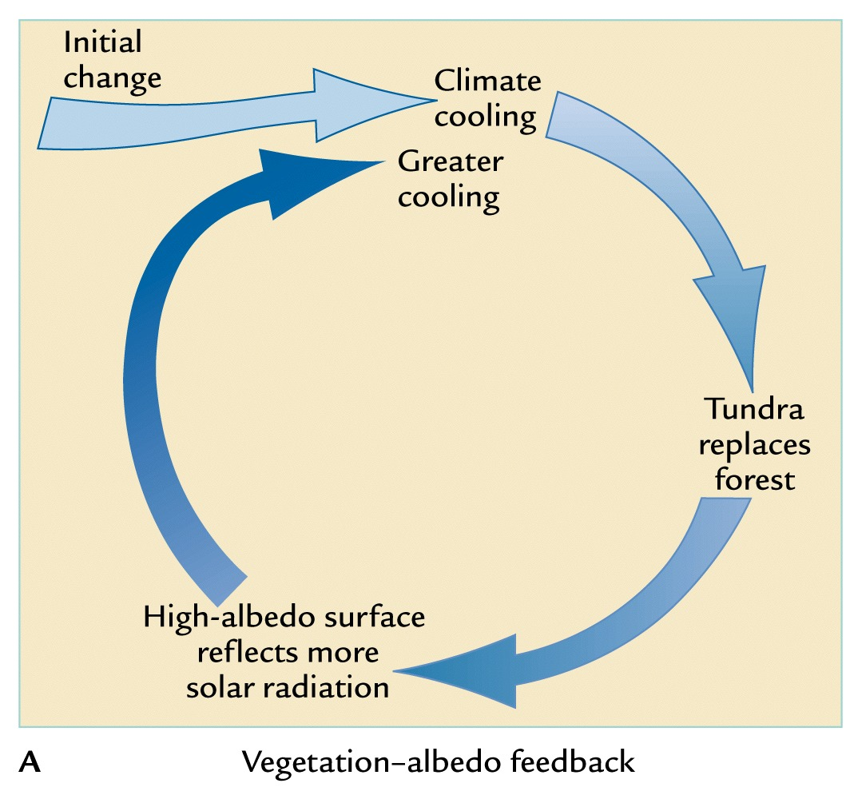
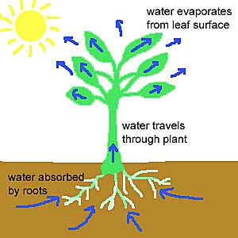
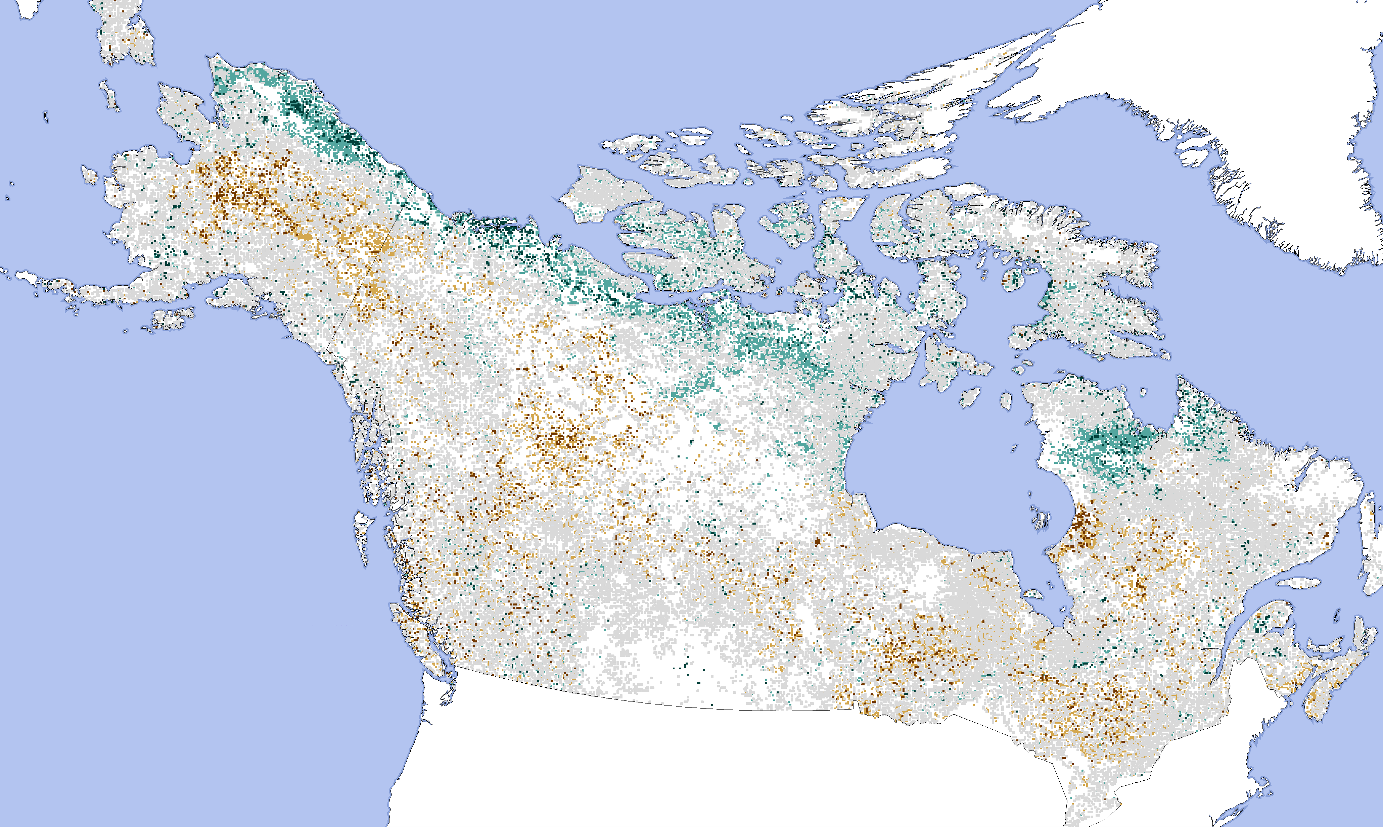
Ice-Albedo Feedback (+)
Water Vapor Feedback (+)
Vegetation-Precipitation Feedback (+)
Vegetation-Albedo Feedback (+)

Slide 23
Uncertainty in Climate Models
Problem: How do we know climate models are right?
Solution: Use a bunch of different ones
No model is the ’True Model’
Multi-Model Ensembles get at structural uncertainty

Slide 24
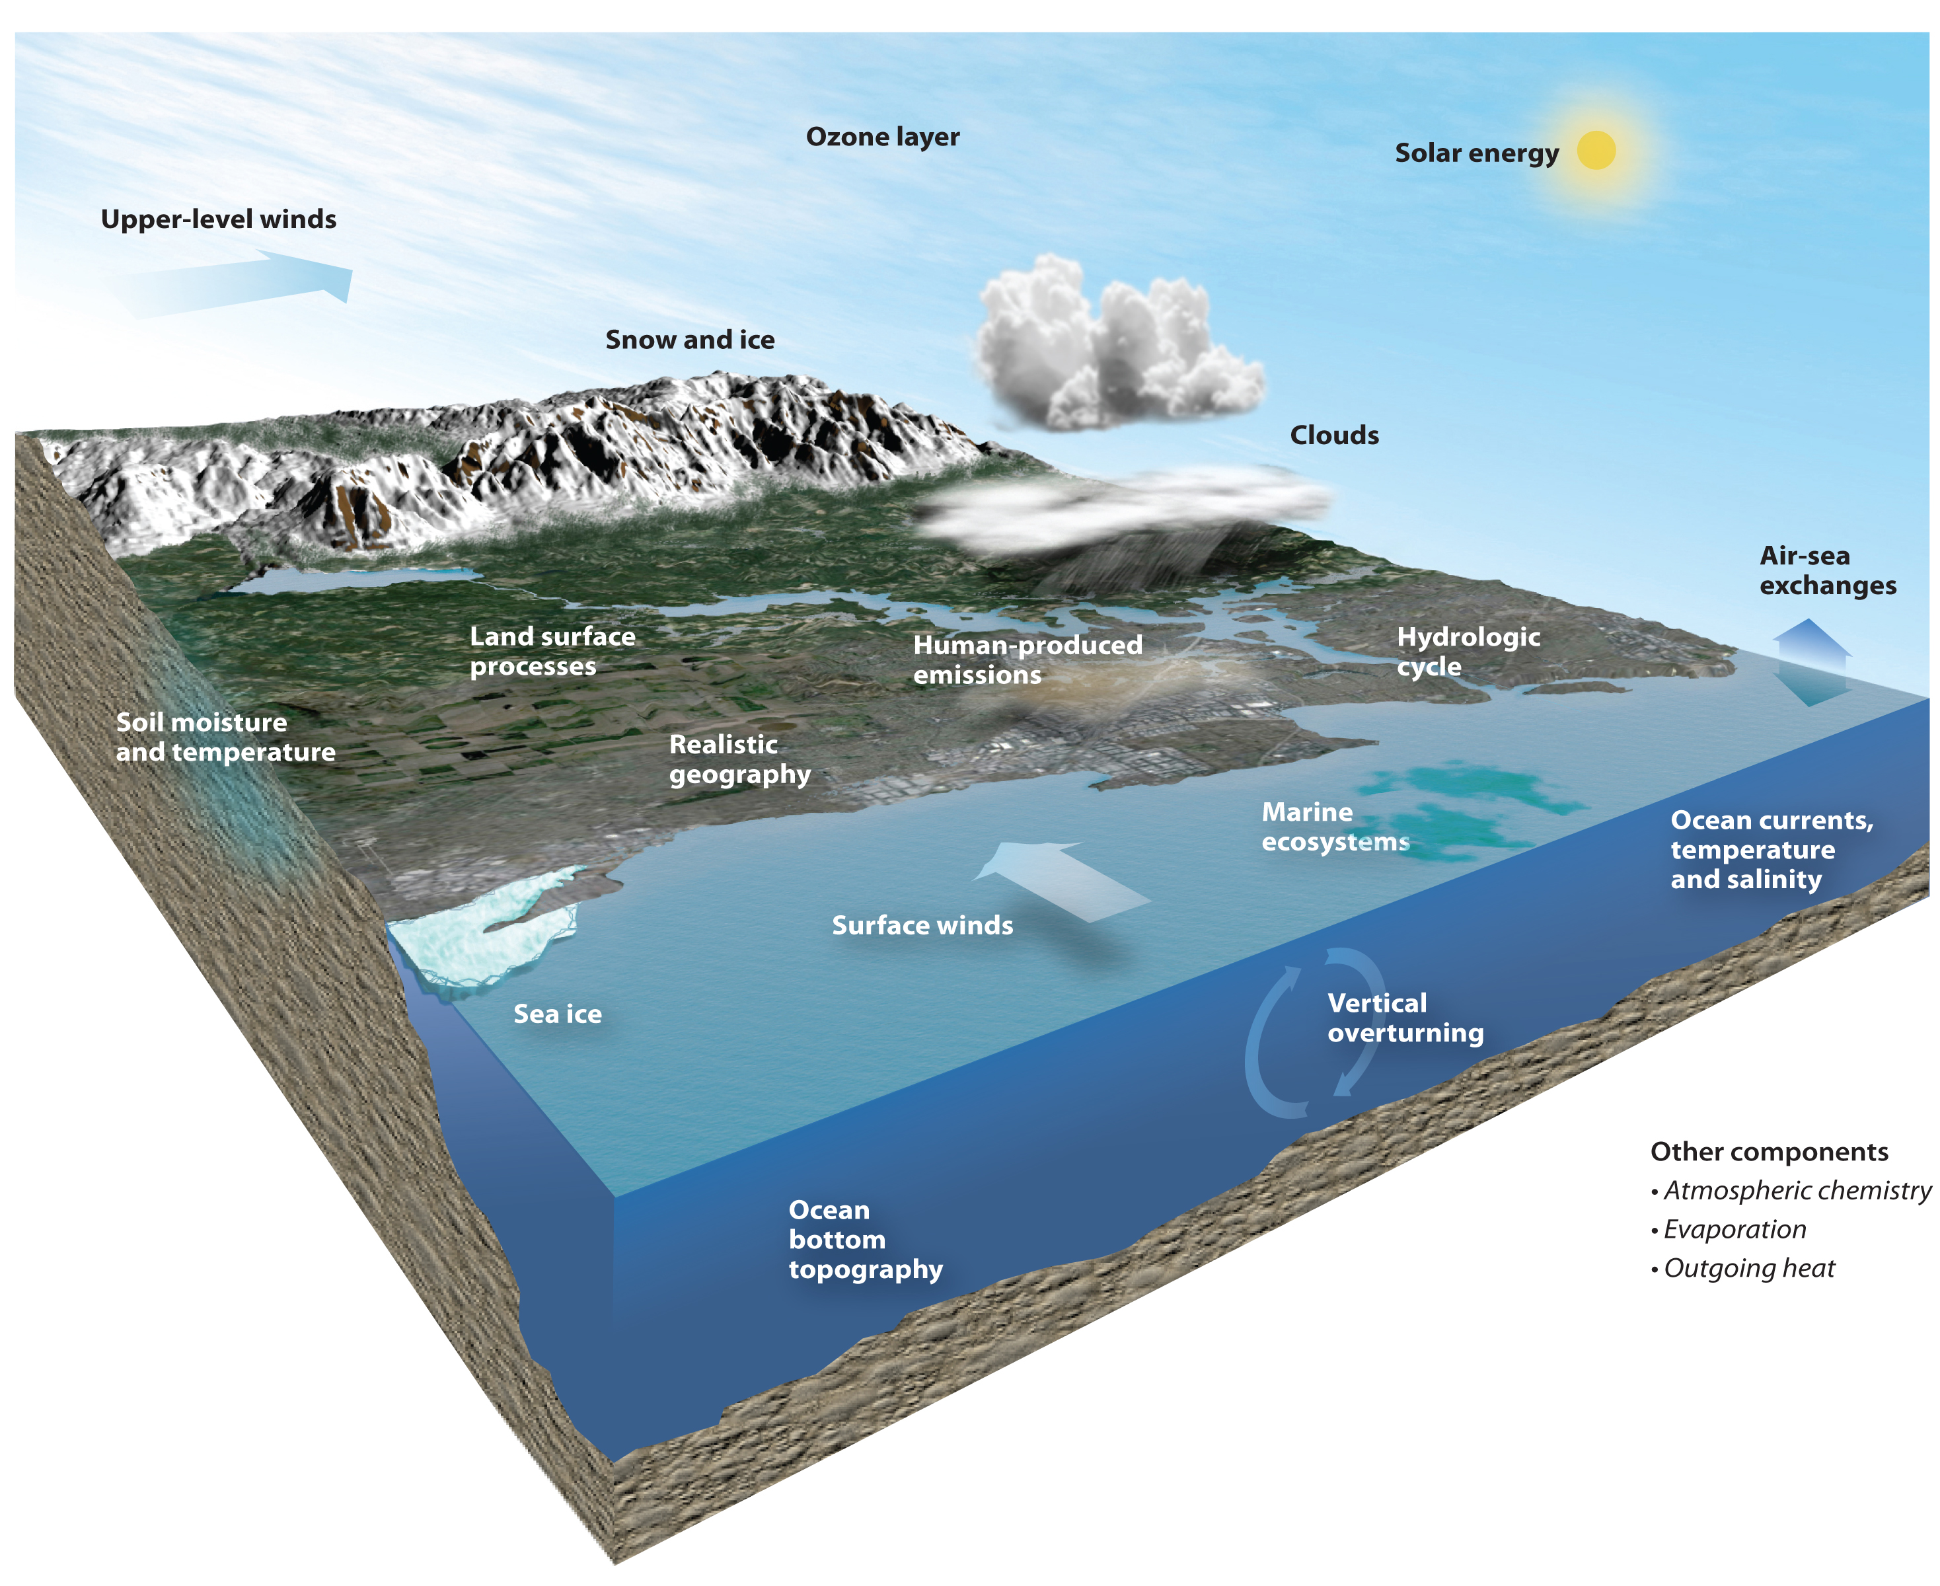
Notes:
What do we mean by structural uncertainty?
The way each model discretizes its domain
Processes it chooses to represent explicitly, and which to parameterize (and values for parameters)

Slide 25
Model simulations reproduce the 20th century observed warming
Are the models any good?
Models forced with an-thropogenic and natural forcing reproduce ob-served warming
Models with only natural forcing do not
IPCC AR5 WGI Fig. 10.1

Slide 26
Problem: Climate change is global, but our experience is local

Slide 27
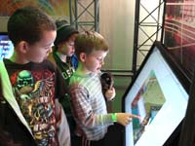
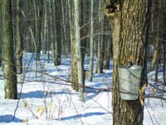
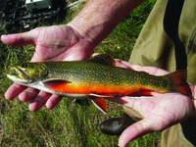
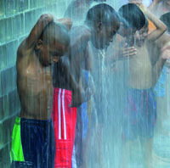
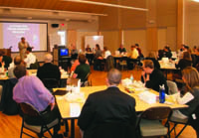
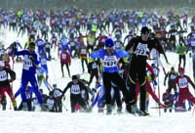
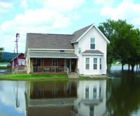
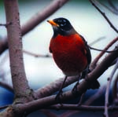
The Wisconsin Initiative on Climate Change Impacts WICCI
WICCI’s mission is to generate and share information that can limit vulnerability to climate change in Wisconsin and the Upper Midwest.

Slide 28
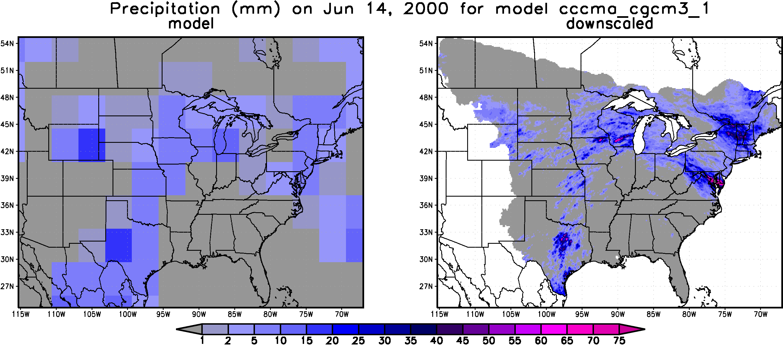
Global → Local Climate Change
Problem: Climate models have coarse spatial resolution.
Downscaling: Focus global projections to a scale relevant to climate impacts.

Slide 29
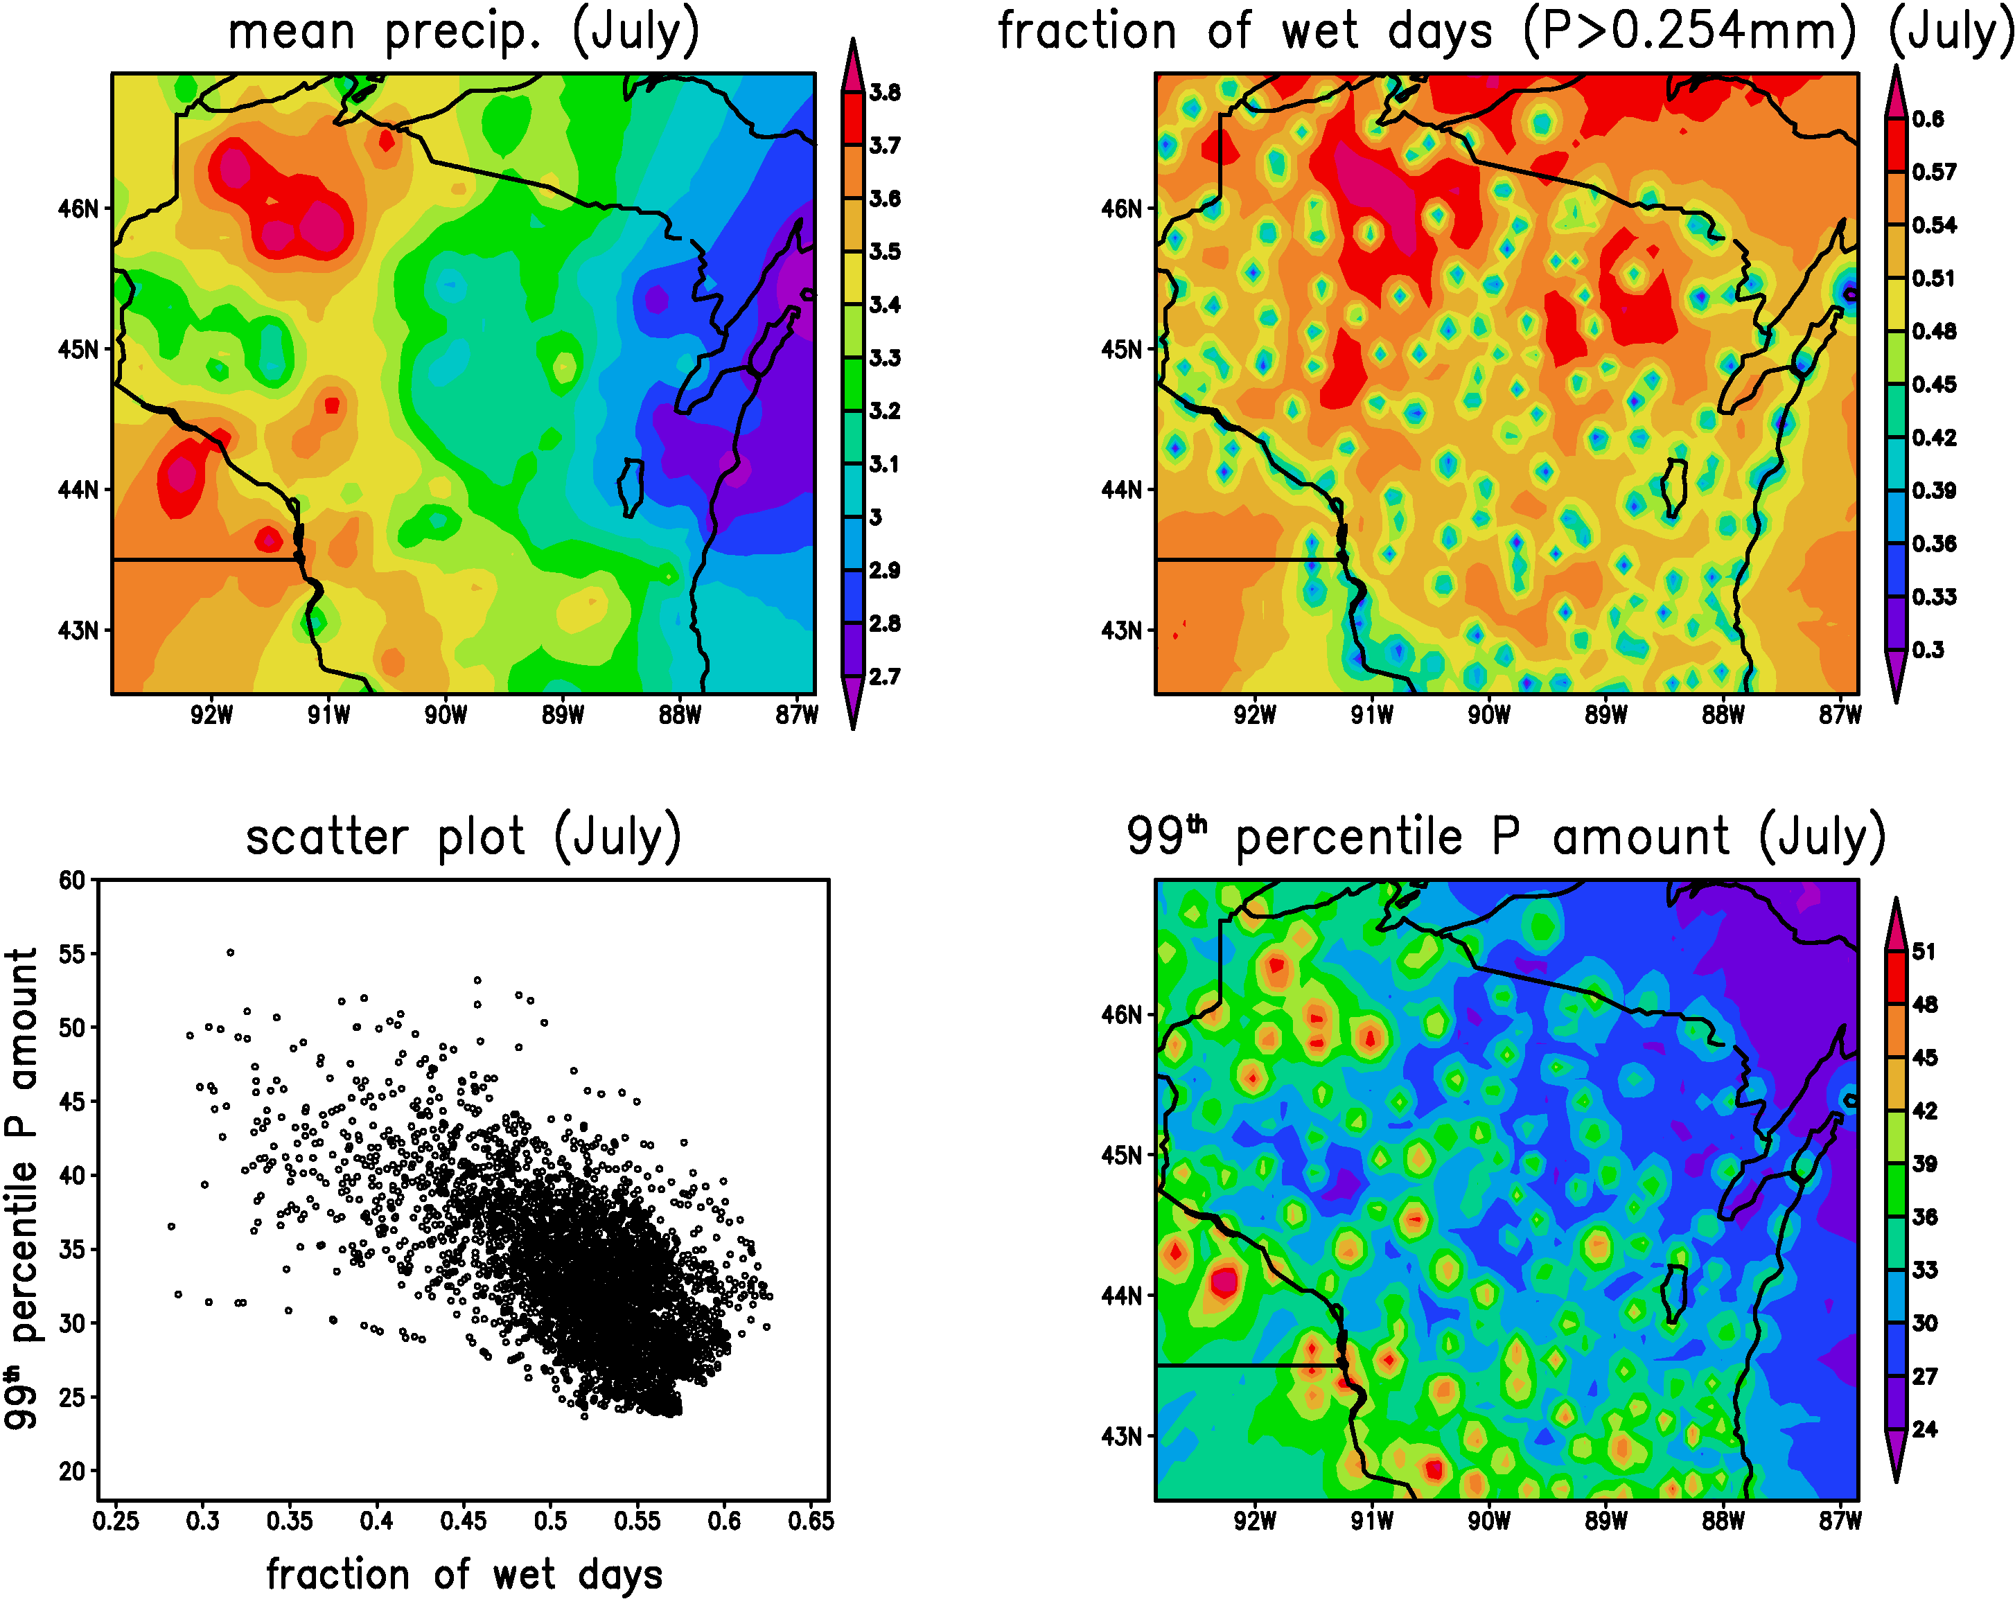
Why methodology matters…
Notes:
If you just use standard interpolation, if it rains at one station and not at the next, it will rain a little bit every where between.
Fraction of wet days for picnic - have it at the co-op station.
If don’t want to get too wet, go to bottom right figure.

Slide 30
WICCI Climate Working Group
http://nelson.wisc.edu/ccr/resources/wisconsin/index.php

Slide 31
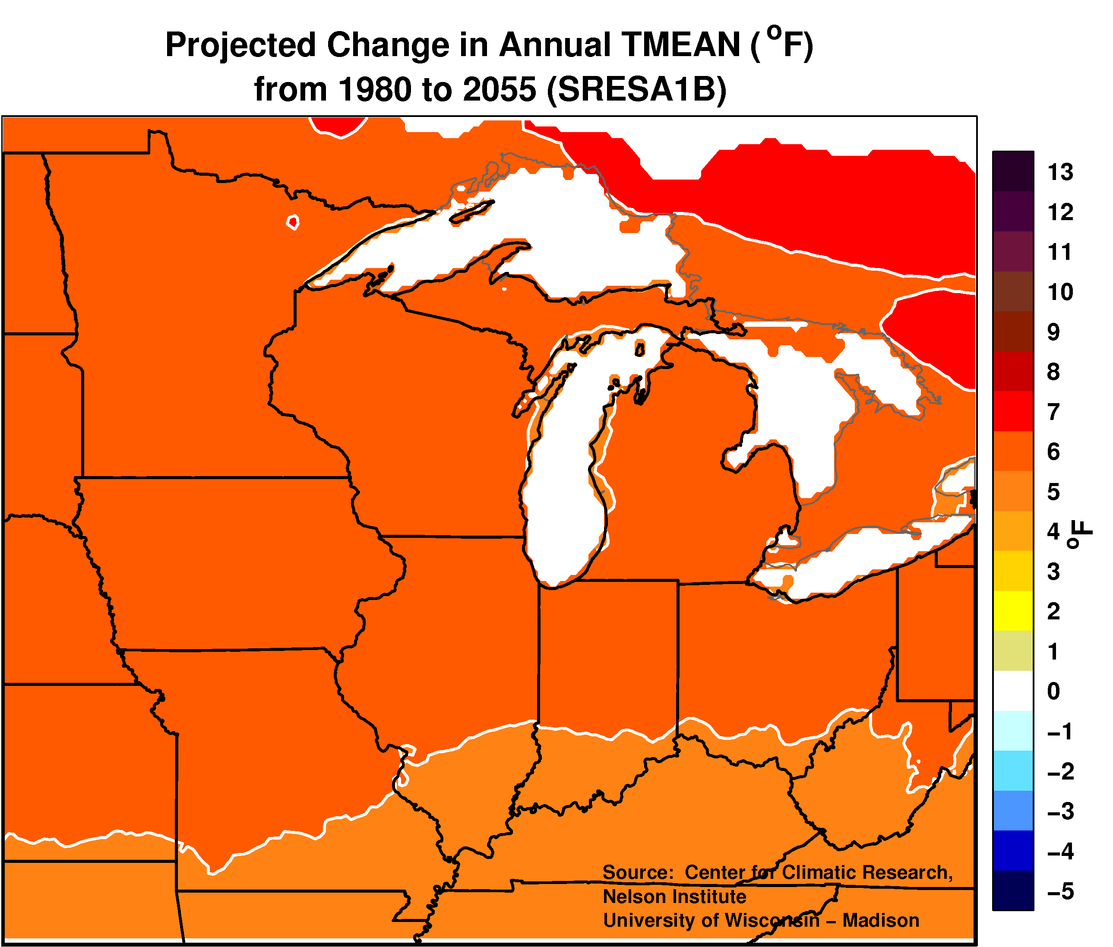
Wisconsin Temperature Change
Notes:
Point out that adaptation is short time scale. At mid centruy, doesn’t matter what scenario. What really matters is getting toward the end of the century.

Slide 32
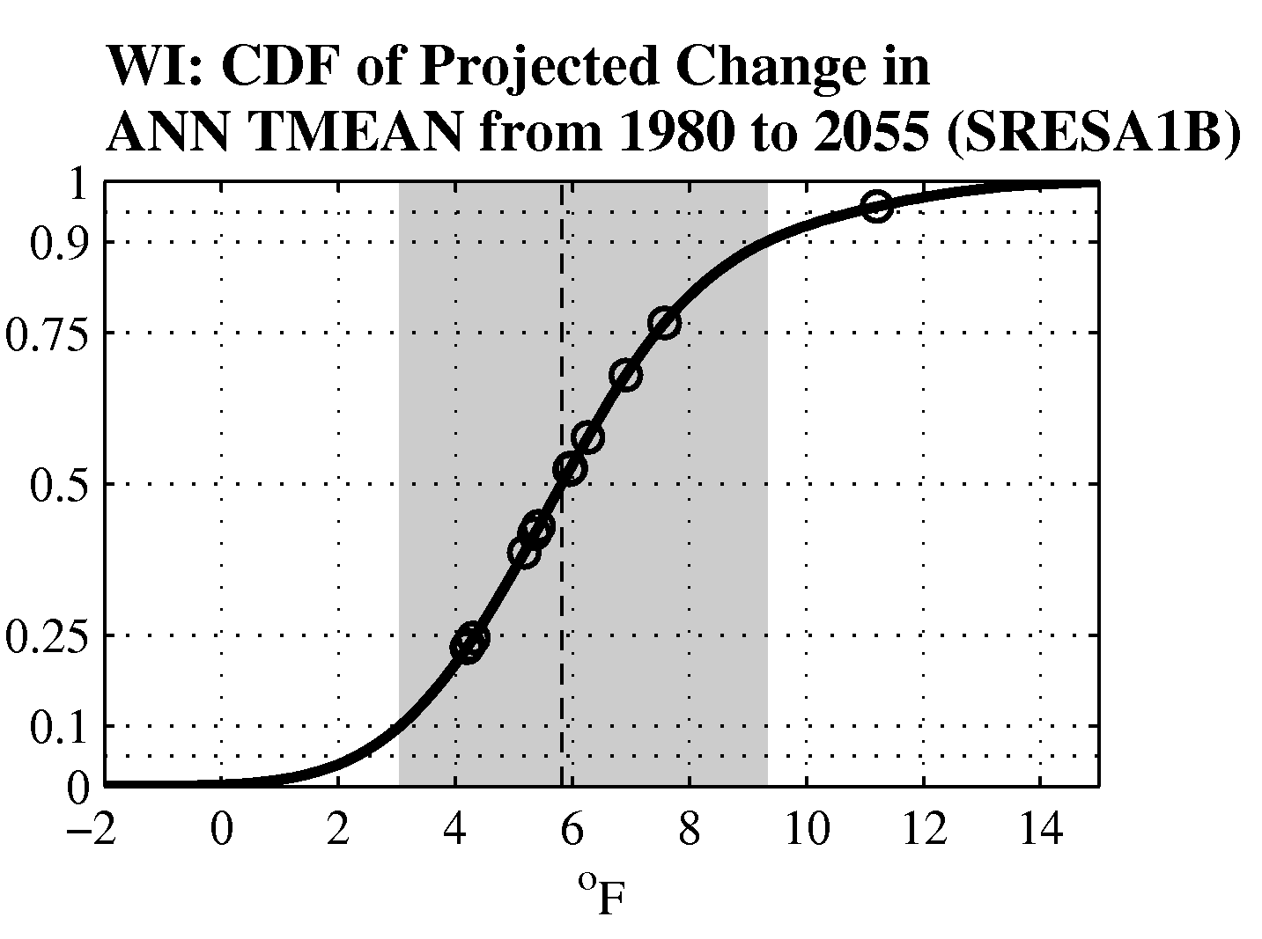
Wisconsin Temperature Change
Wisconsin will warm by 3° – 9°F by mid-21st century
Notes:
One number doesn’t help much – loook at probability distrivutions, the CDF. If you’re teaching math or stats, great way to bring in probability. If you’re just trying to get people to understand climate change, you can use this, but use 3 numbers, min, median, max.

Slide 33
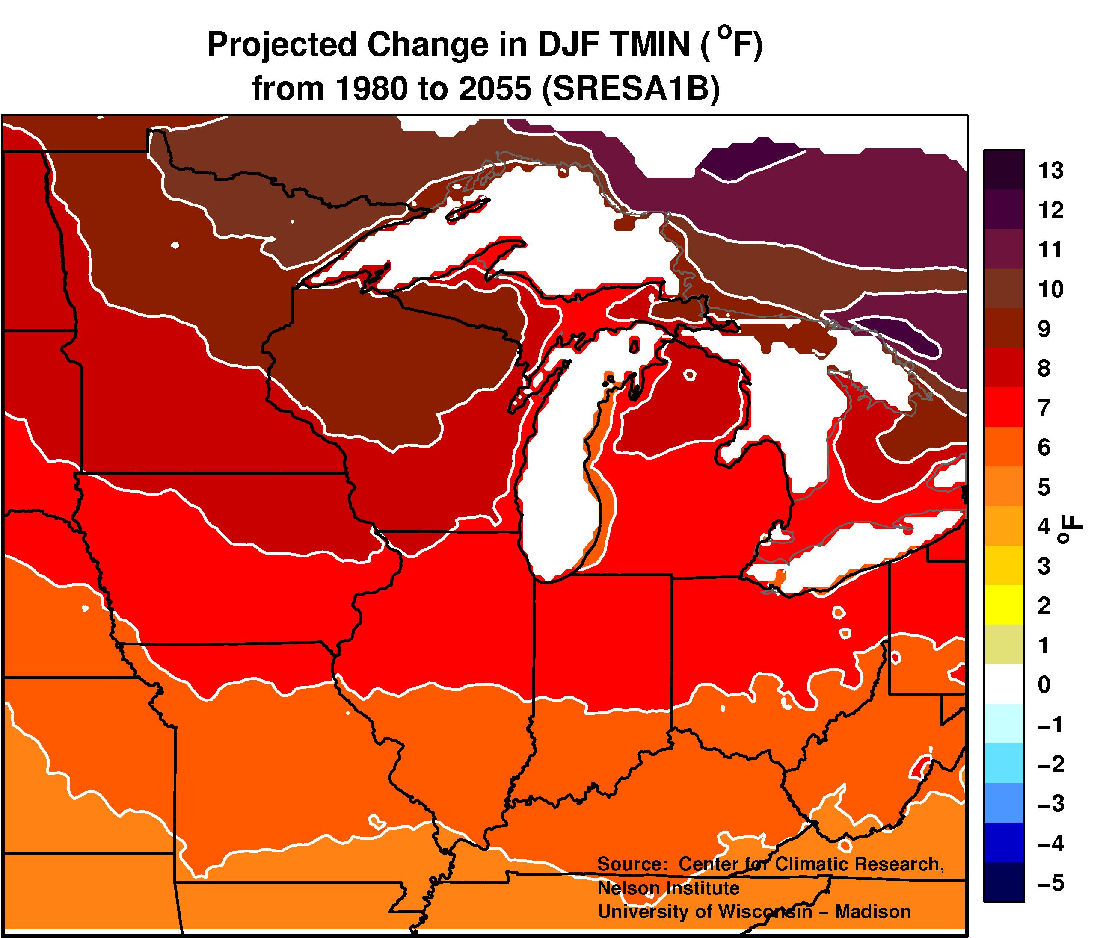
Winter Temperature Change
Warming is most pronounced for winter nights (Wisconsin winters warm by 5°– 12°F by mid-21st century)

Slide 34
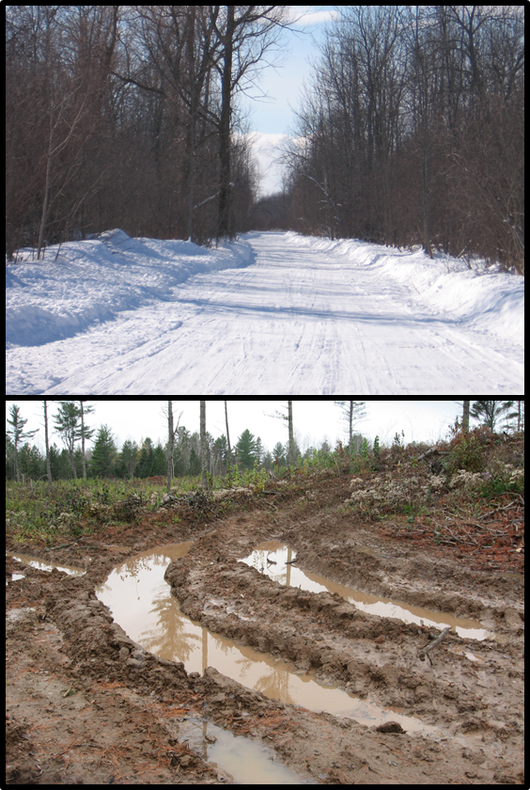
Warmer Winters
What does it mean?
Notes:
Analysis of timber harvest records identified a
shift toward greater harvest of jack pine and red pine and less harvest of aspen, black spruce, hemlock, red maple, and white spruce in years with less frozen ground or snow duration.
Interviews suggested that
frozen ground is a mediating condition that enables low-impact timber harvesting.
Climate change may alter frozen ground conditions with complex implications for forest management.

Slide 35
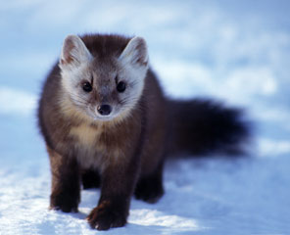
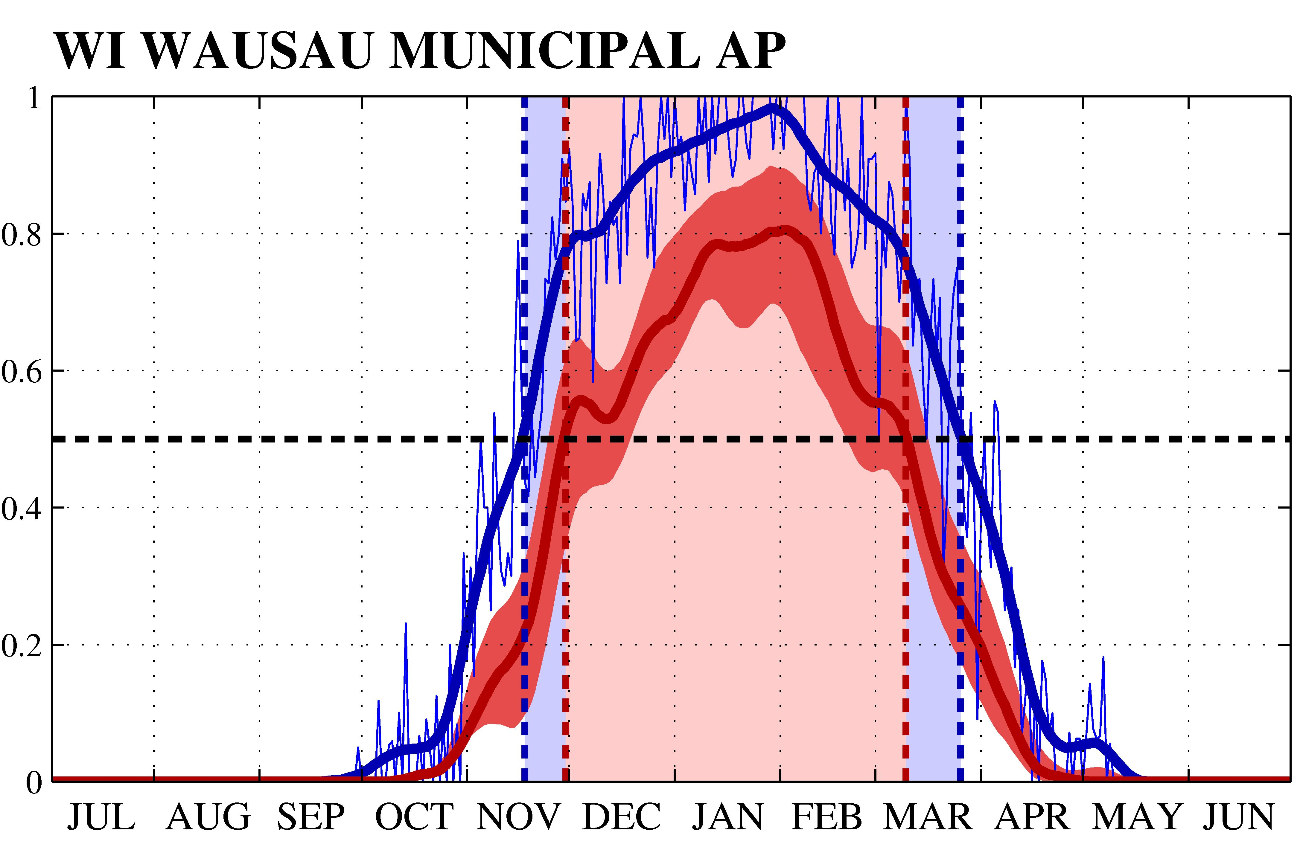
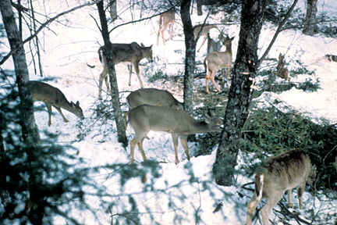
Warmer Winters
What does it mean?
Warmer Winters ⇒
Snow cover changes
Snow
Rain
Shorter Snow Season
http://dnr.wi.gov/
Notes:
(Source: Karl Martin, WI DNR, personal communication, 2008): The pine martin (top) has evolved to have big paws (take a look at the picture), so it does better in snow than it’s competitors (the bobcat? Lynx? I can’t recall at this time). Also, less snow means more opportunities for deer, which mow down yellow birch – an important source of habitat for pine martins. More rain-on-snow events means less snow, and is bad for pine martins.

Slide 36
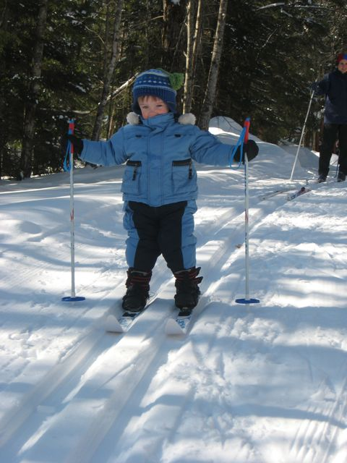
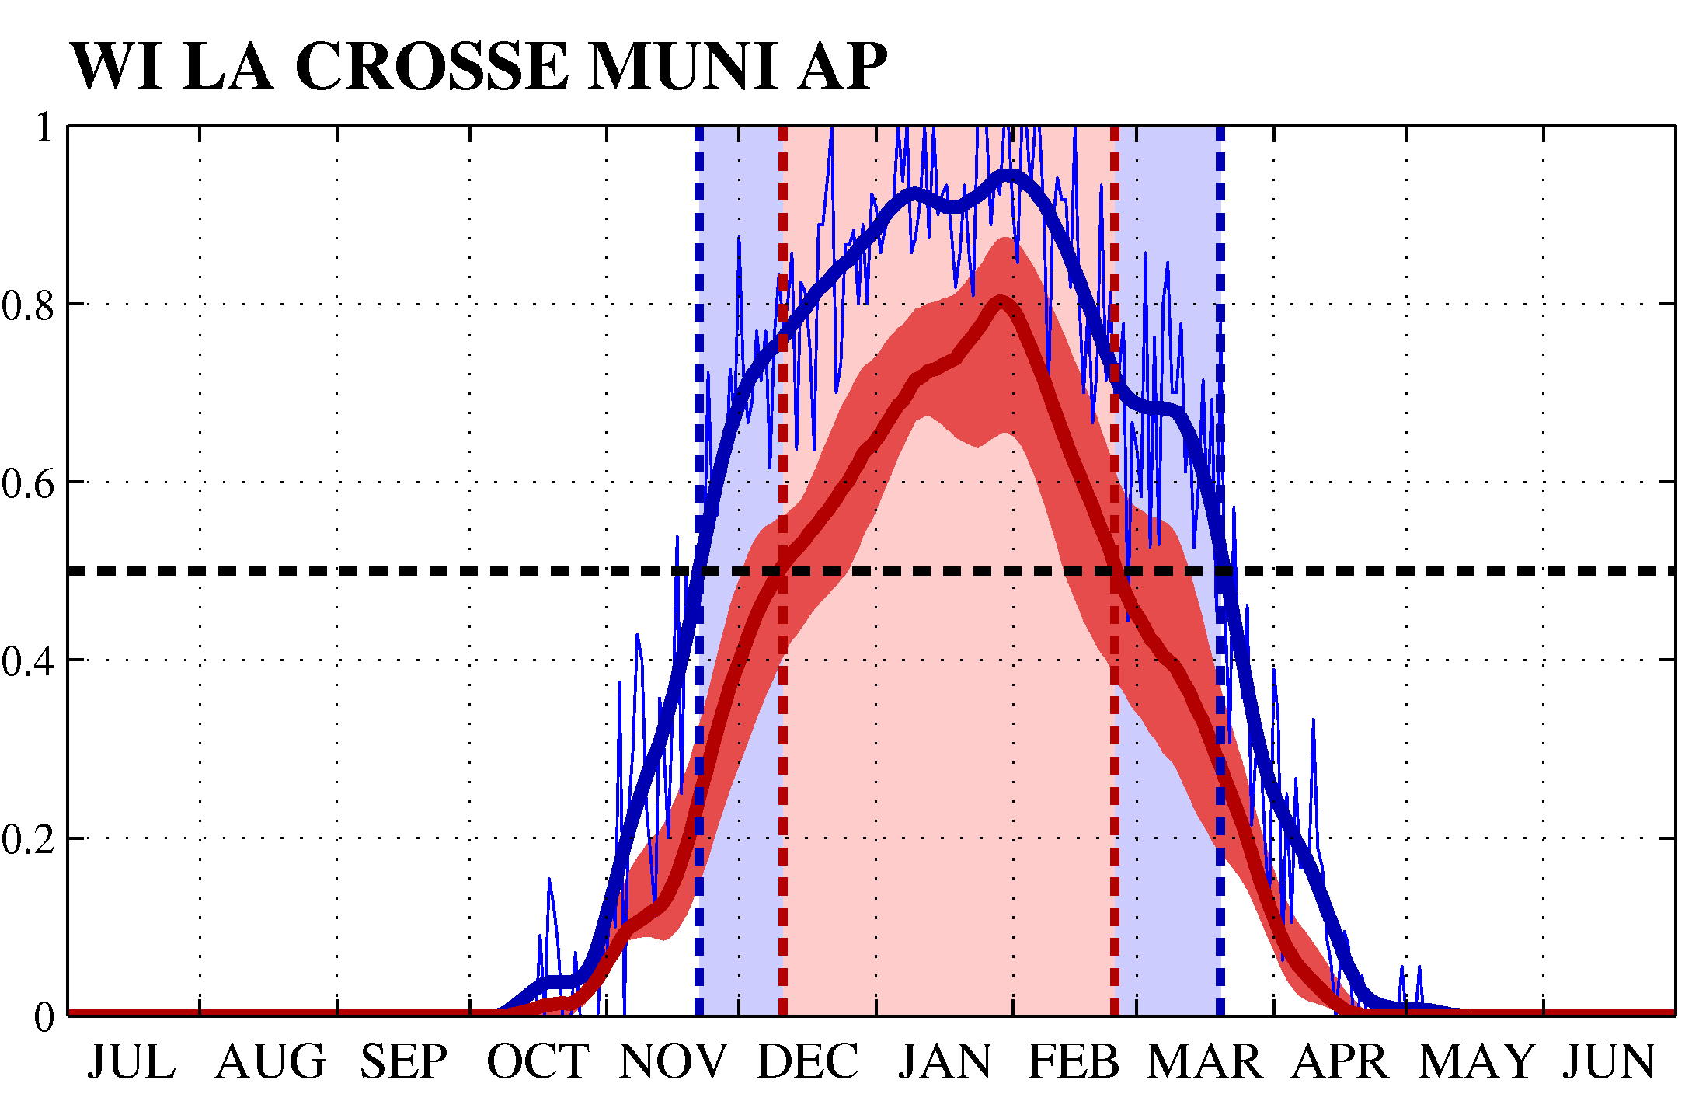
Warmer Winters
What does it mean?
Warmer Winters ⇒
Snow cover changes
Snow
Rain
Shorter Snow Season
Notes:
The plot shows the probability that, given that some sort of precipitation is falling, that precipitation is snow rather than rain. The blue curve is for present-day conditions, and the red curve(s) are for the end of the 21st century. So, the blue curve shows that in January, 9 out of 10 precipitation events will be snow, not rain. By the end of the 21st century, 7 out of 10 precipitation events will be snow – so 3 out of 10 events will be rain, in the middle of January. We can also define a “snow season” based on when the probability of snow exceeds some threshold, like 50%. Note that the snow season shortens considerably.
Despite warming trend, snow fall has increased over the last 50yr (something we need to explain). This may continue for a while, then reverse. Also, the duration of snow cover may change significantly.

Slide 37
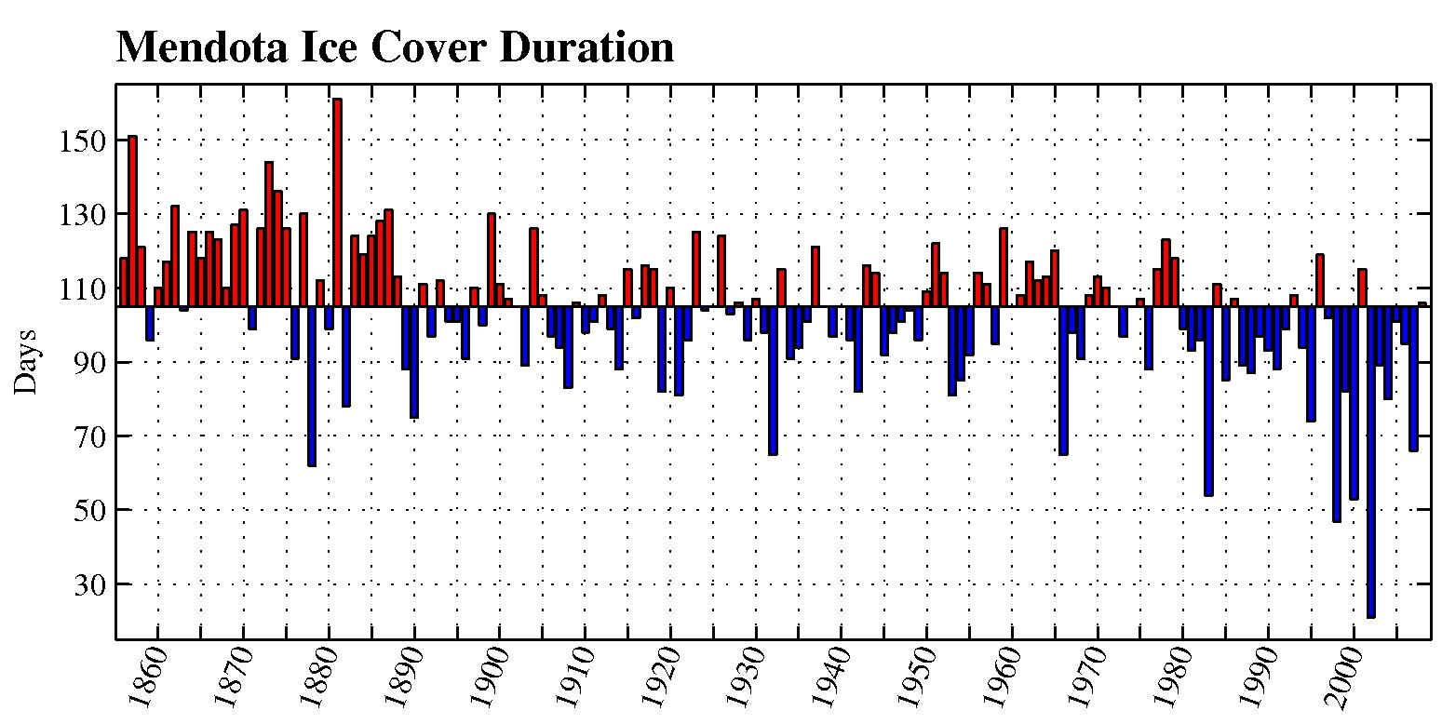
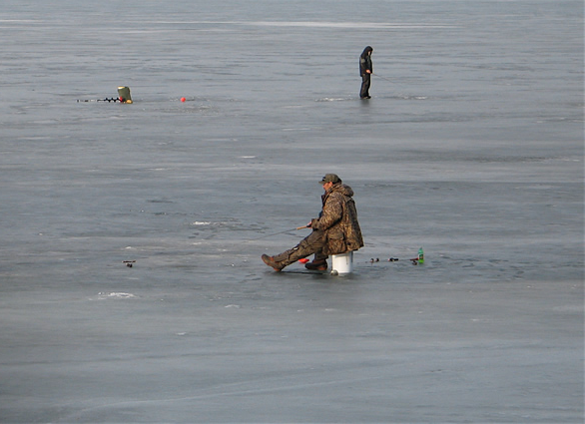
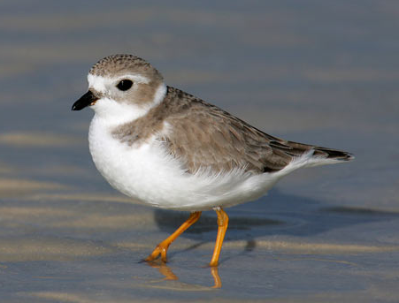
Warmer Winters
What does it mean?
Warmer Winters ⇒ Shorter Ice Duration
Ice data c/o J. Magnuson
Notes:
Ask if people can identify the bird. Make a big distinction between climate science and impacts, how we need communication to understand values.
Duration of ice cover for Lake Mendota: Large, decreasing trend. Impacts recreation (ice fishing season, kites on ice) and transportation (Madeline Island Ice Road). Also affects wildlife indirectly: ice cover scours vegetation in Piping Plover habitat. That vegetation can be a hiding place for predators; ice plays a crucial role in removing that cover.
When there’s more vegetation there is room for predators to hide, that’s bad for the bird. There is no way I could know this as a climate scientist – we are lucky to have a wide variety of knowledgeable experts.
This is a good exercise for students – here’ the piping plover, who needs to be in the room in order to understand this. Wildlife, climate, community planners, conservation managers, politicians, DNR regulatory people, etc.

Slide 38
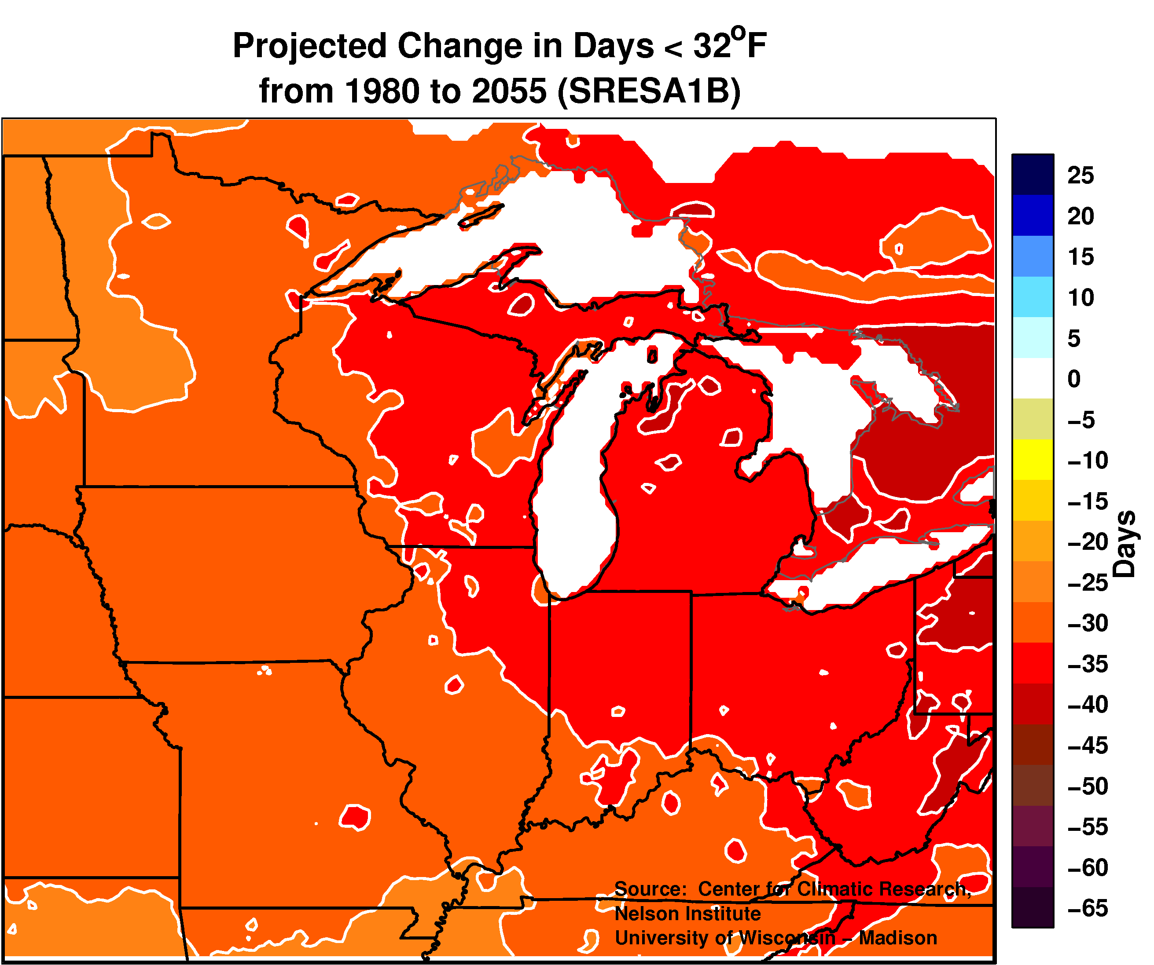
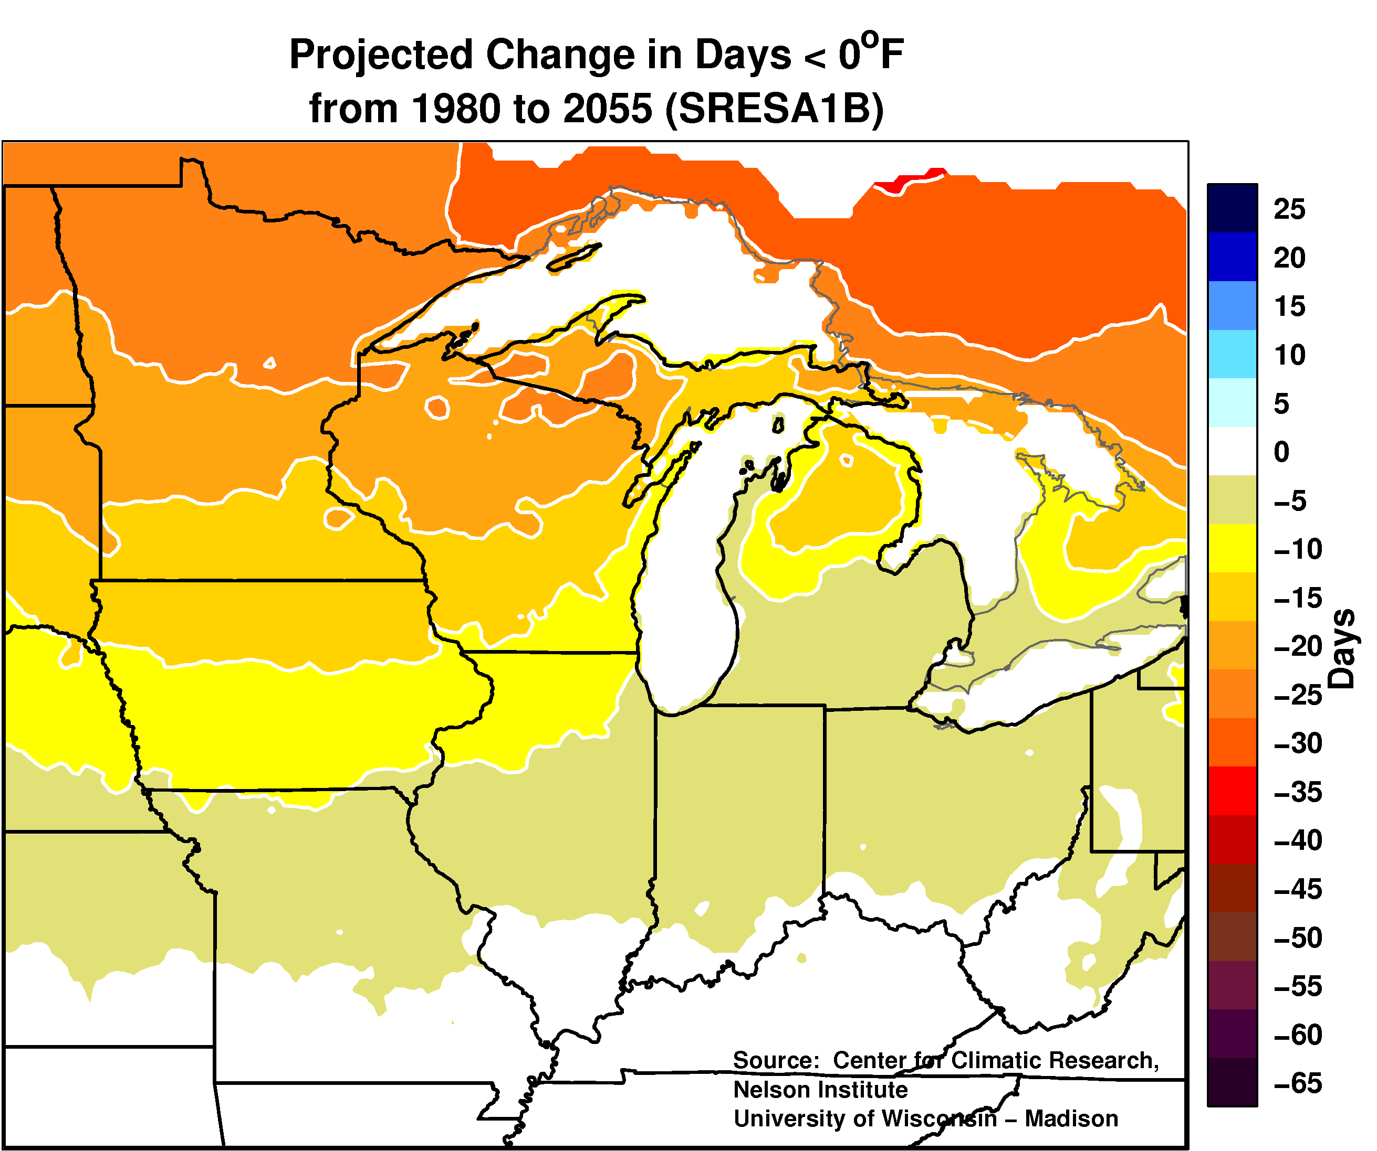
Cold Days
Days > 32°F
Days > 0°F
Fewer Cold / Extremely Cold Days
Notes:
Madison: 13d tmax>90F; 20d tmin<0F
Wausau: 6d tmax>90F; 30d tmin<0F

Slide 39
Impacts of Extreme Cold
Invasive species, reduced access
Notes:
SHOW THIS AT THE BEGINNING OF THE PRESENTATION.

Slide 40
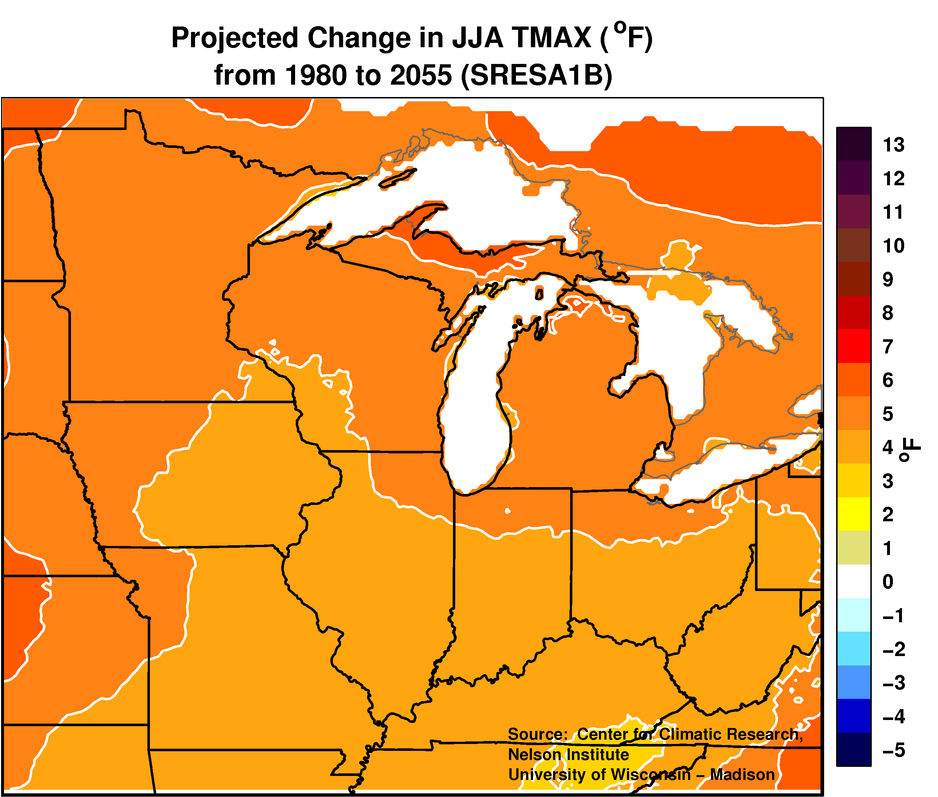
Summer Temperature Change
Warming is least pronounced for summer days (Wisconsin warms by 2°– 8°F by mid-21st century)

Slide 41
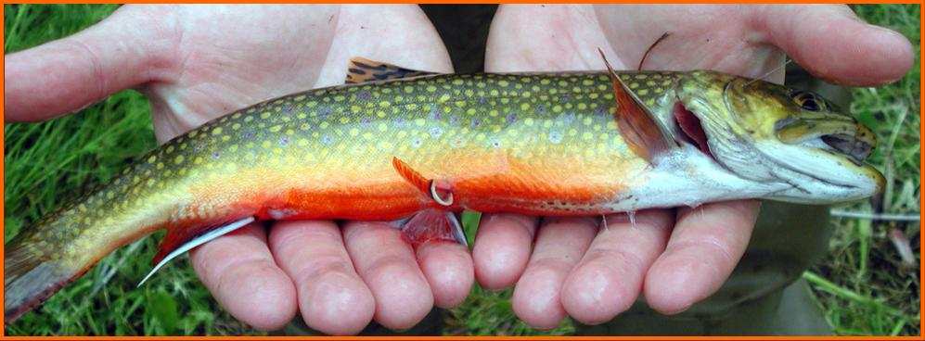
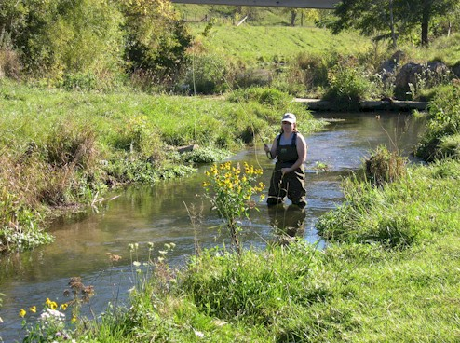
Warmer Summers
Source: Mitro et al. (2010)
Notes:
Still hs big impact on fish populations. Heres where you use low, mdedium and high values from CDF.

Slide 42
Warmer Summers
Current Climate
Brook Trout
BrownTrout
Source: Mitro et al. (2010)
Notes:
These have been redone to include: groundwater input and the driftless area becomes one of the last refugia for broook and brown trout in the state.

Slide 43
Warmer Summers
+1°C Air (+0.8°C Water)
Brook Trout
Brown Trout
Source: Mitro et al. (2010)

Slide 44
Warmer Summers
+3°C Air (+2.4°C Water)
Brook Trout
Brown Trout
Source: Mitro et al. (2010)

Slide 45
Warmer Summers
+5°C Air (+4°C Water)
Brook Trout
Brown Trout
Source: Mitro et al. (2010)
Notes:
Mitigation keeps us farther from this, but we will have to adapt.

Slide 46
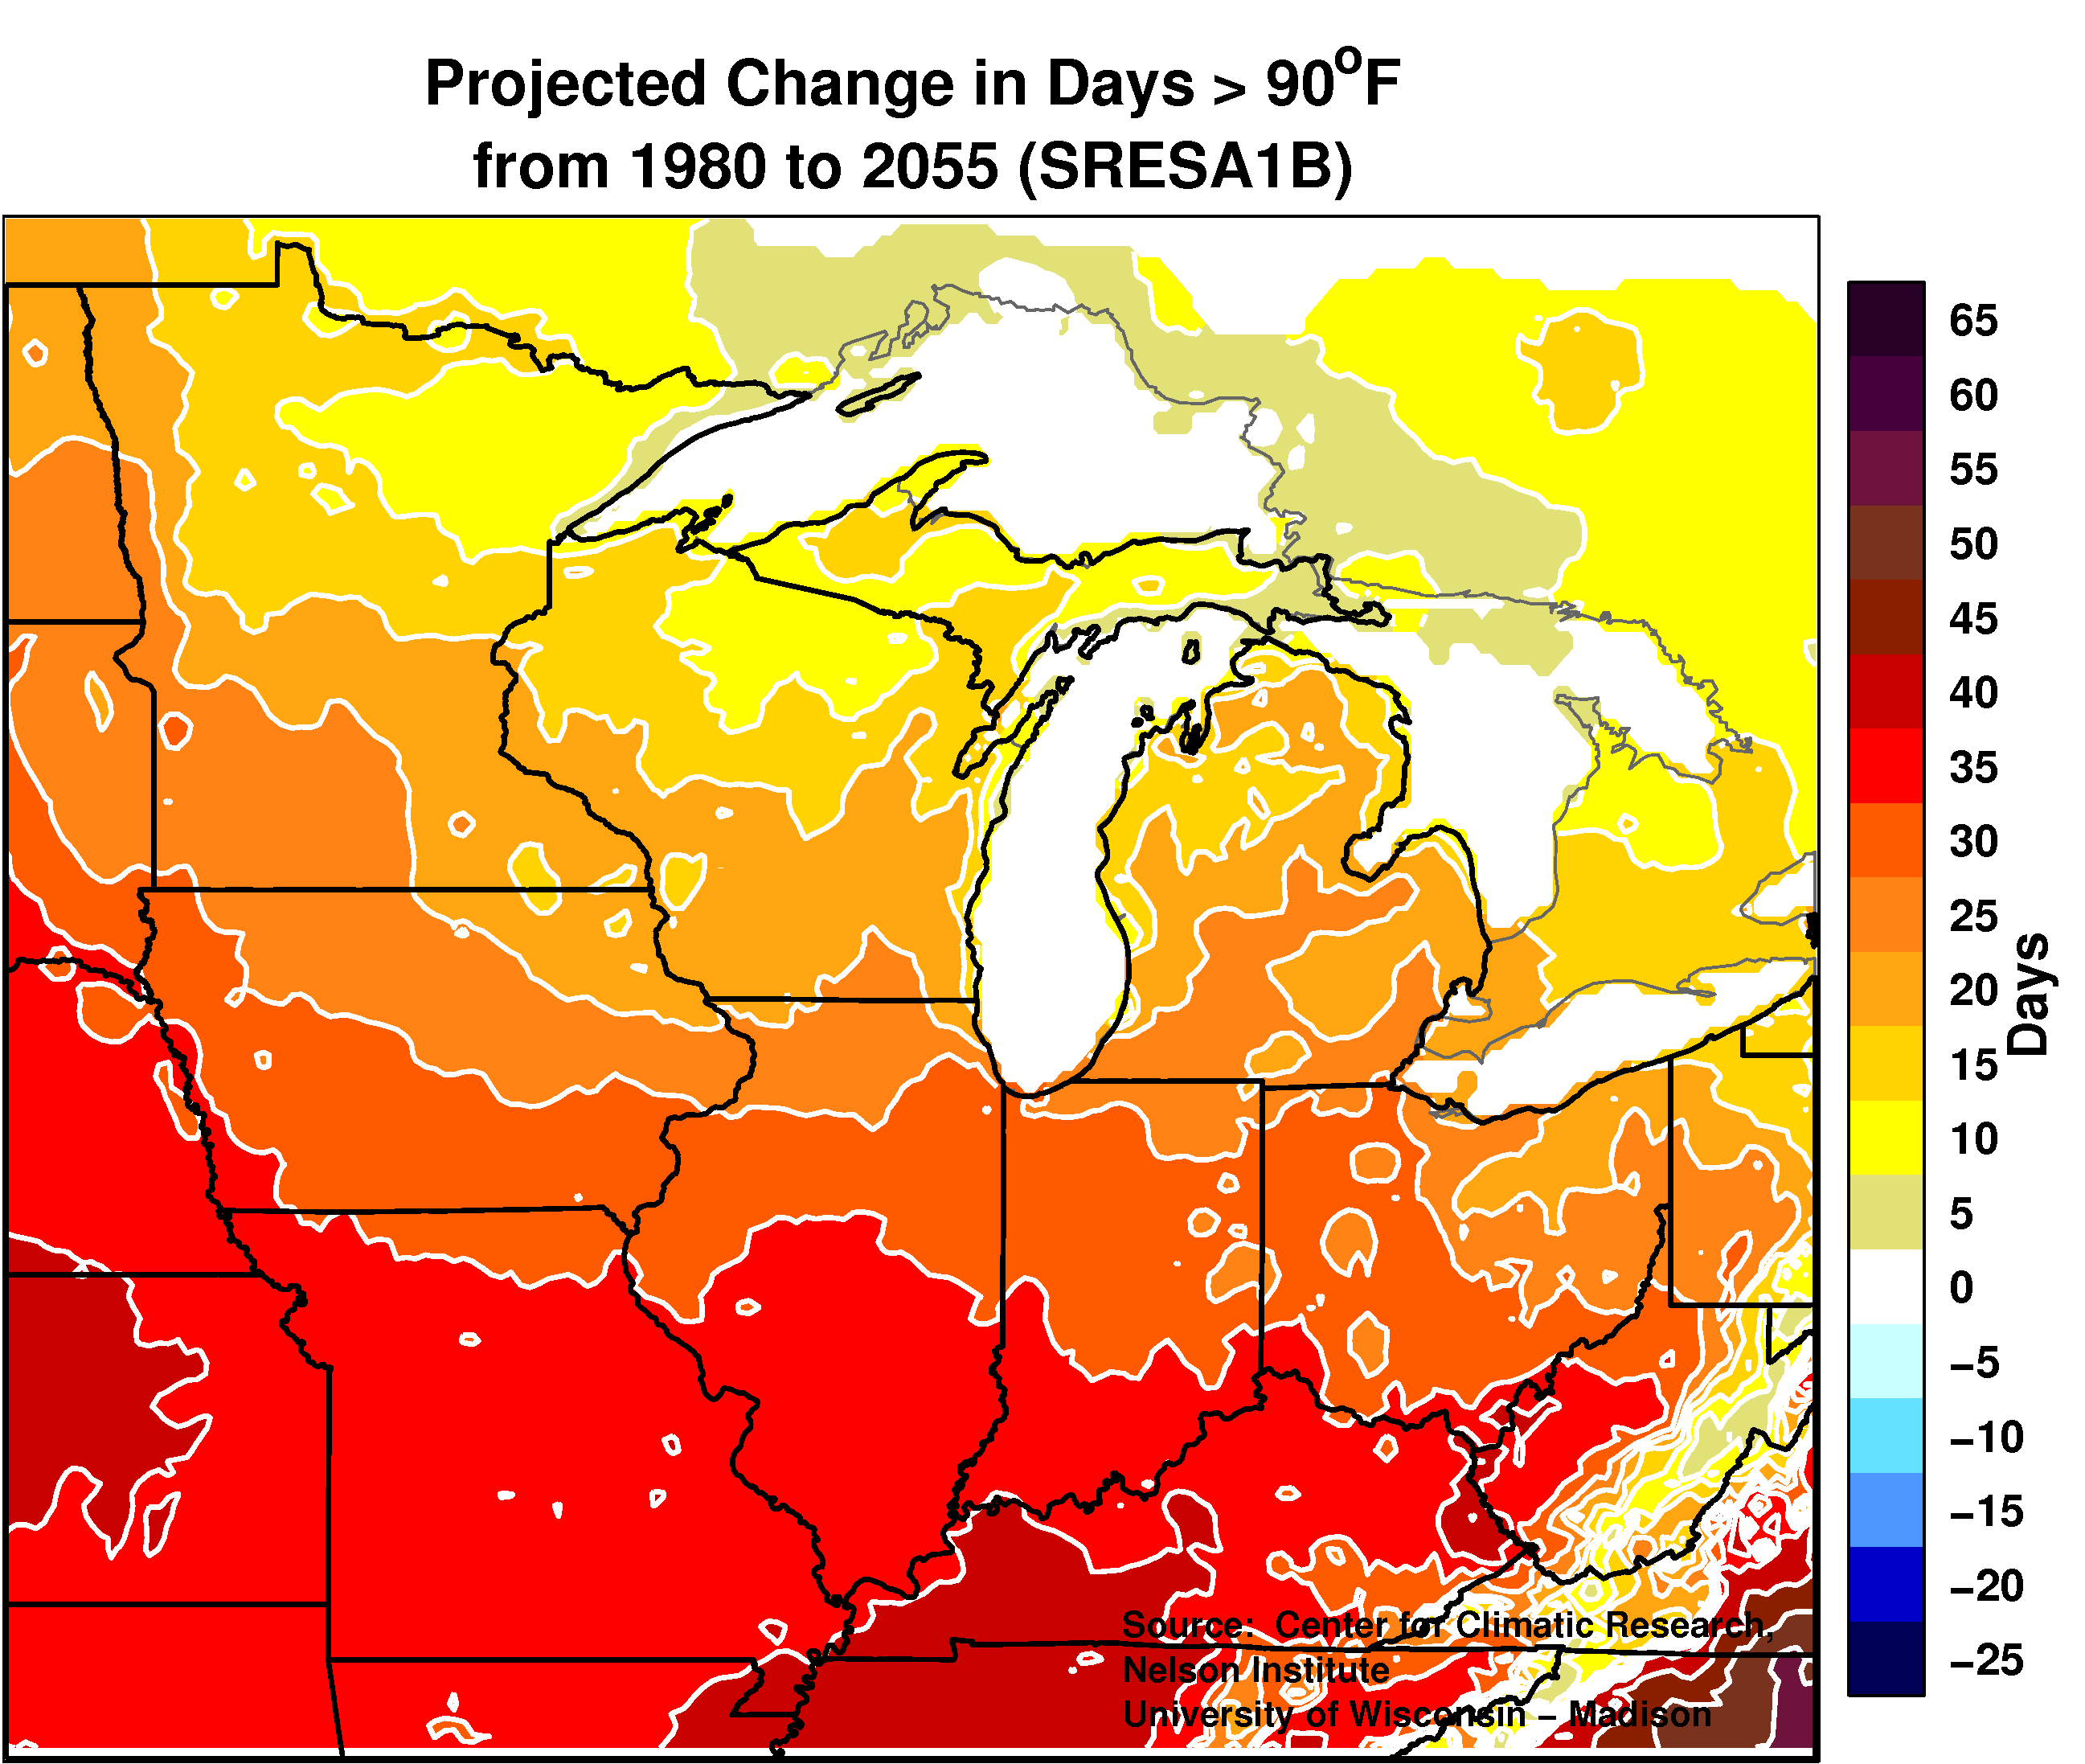
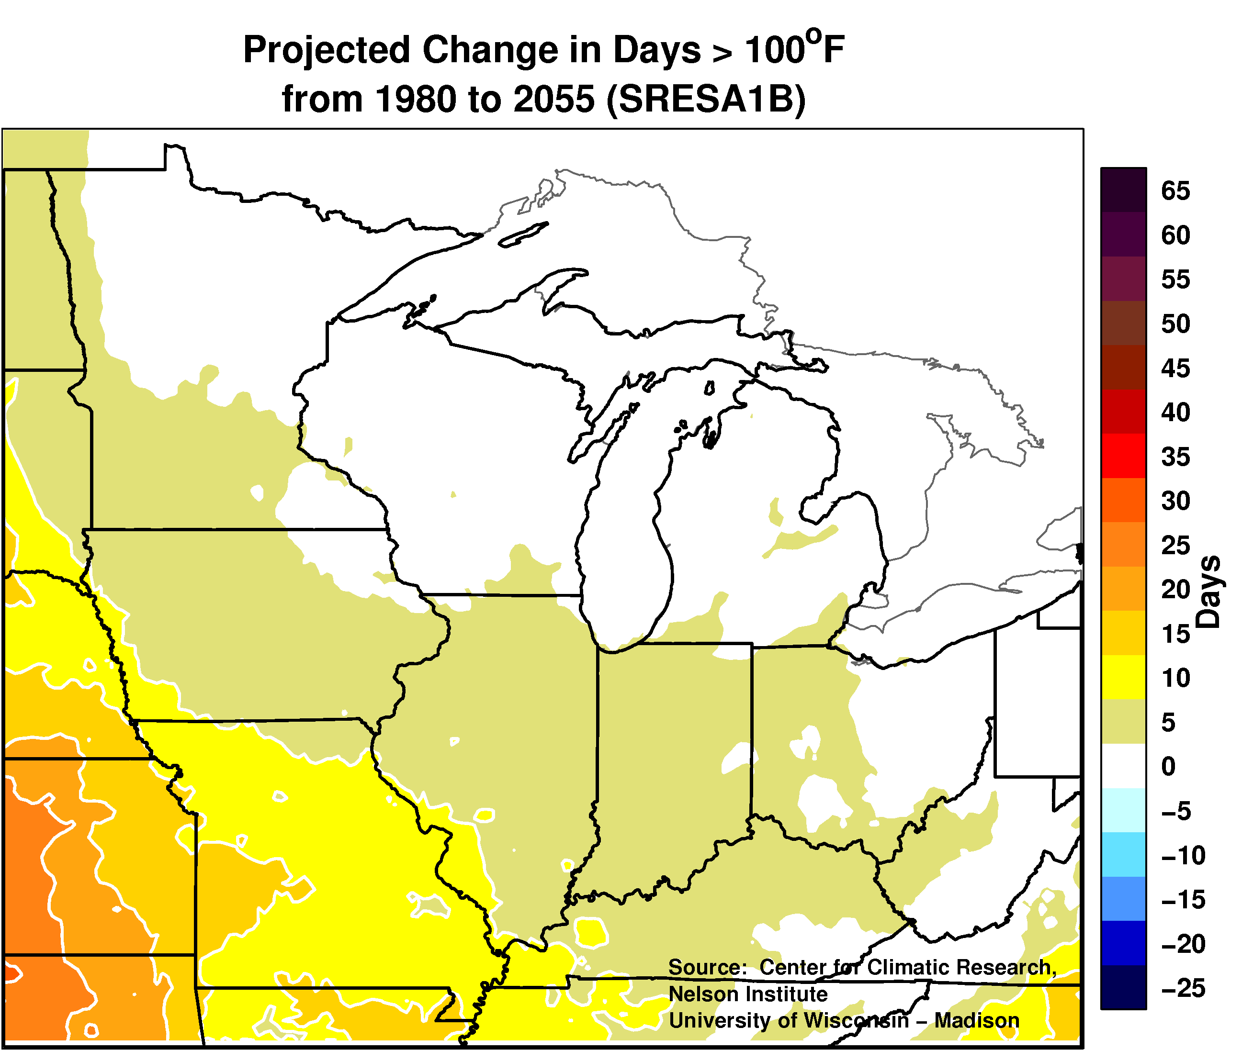
Extreme Heat
Days > 90°F
Days > 100°F
Mid-Century: More “very hot” days
Notes:
Madison WI: 90D – 6 days / yr. 100F – 1 day per five years

Slide 47
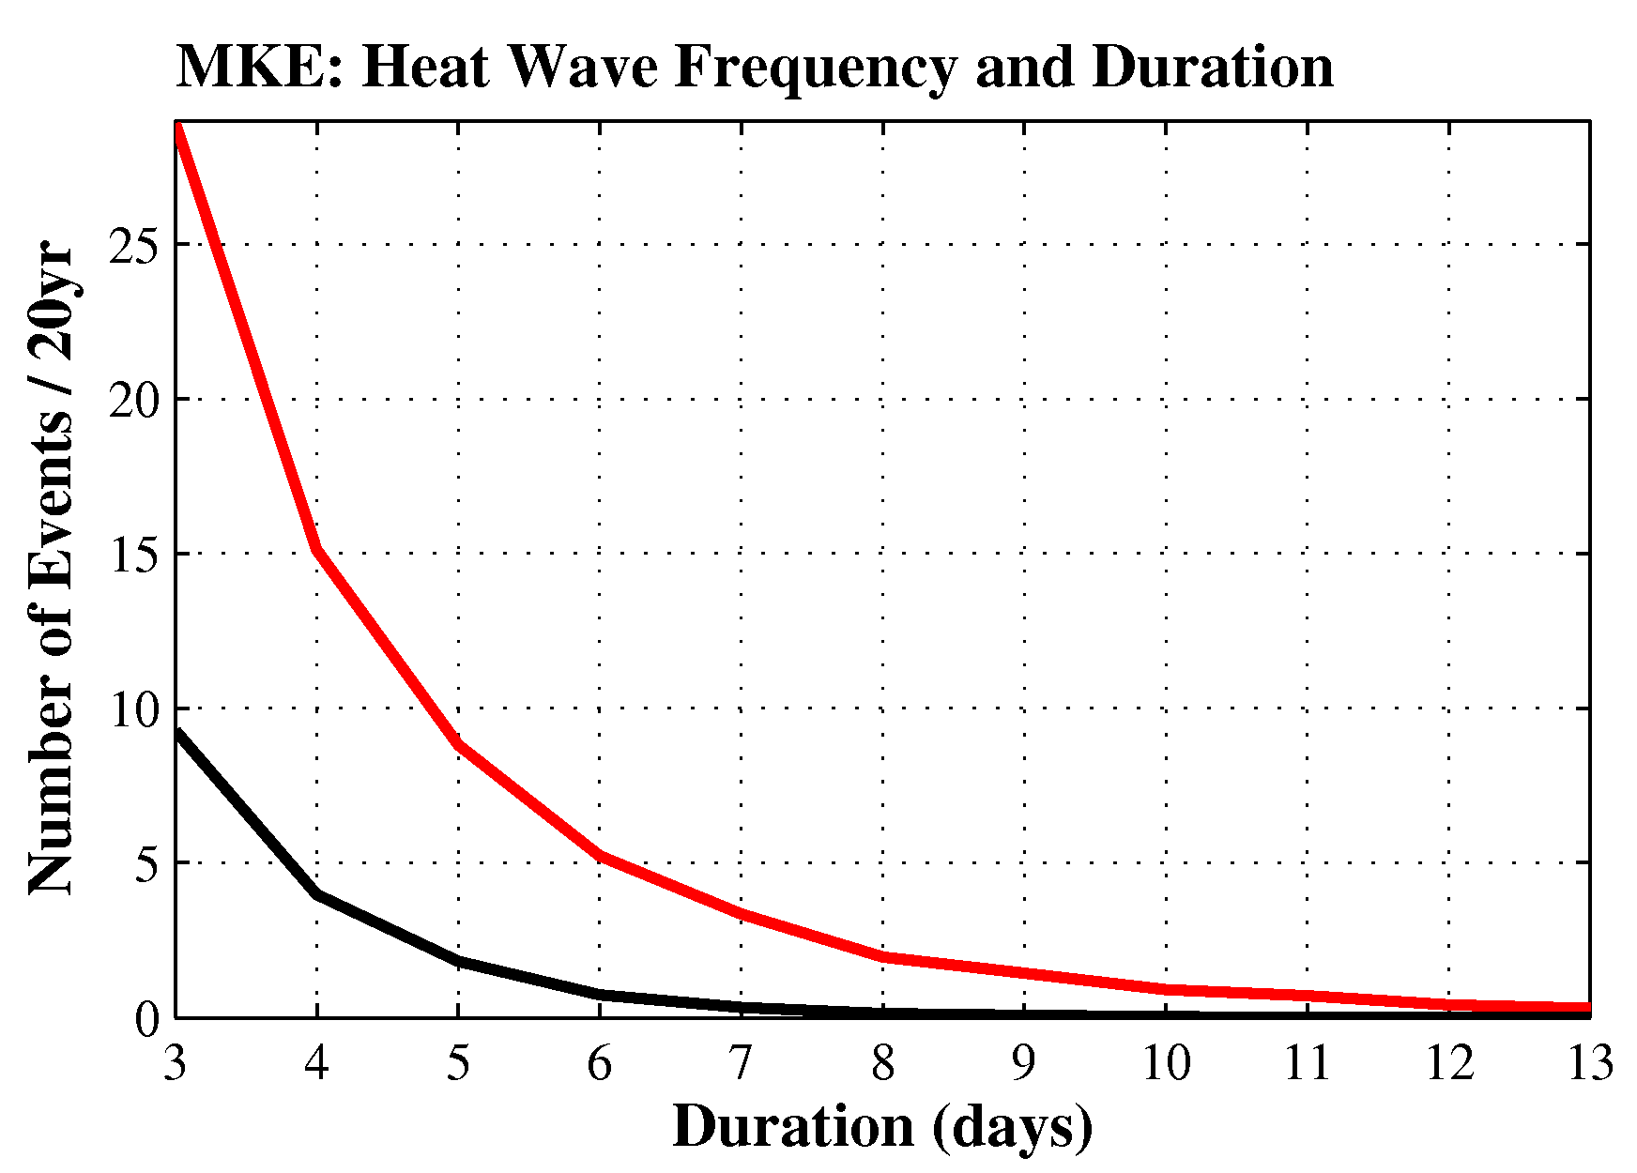
Extreme Heat: Daytime Highs
Realistic temporal structure allows investigation of event duration.
Days > 90°F
Heat waves: 3 to 5
times more frequent
Notes:
Since 1982, extreme heat has caused more deaths in WI than all other natural disasters combined.
Energy demand spikes after 3 day heat waves b/c/ people get sick of waiting even if getting paid. Only way to know this is by being in communication with energy industry.
So Impacts are necessarily and individualized thing. Emphasize how values are necessarily intertwined with the impacts. This makes for a very complex problem.

Slide 48
Winter Precipitation Change
Robust increase in Precipitation during Winter and Spring
Notes:
Summer could be wetter or drier, it’s one of the known unknowns. We know why we don’t know what will happen in summer.
However, evapotranspirtaion will increase, leading to higher chance of drought, more prevalence.

Slide 49
Large Precipitation Events
Wisconsin could see a 30% increase in the number of large rainfall events
Notes:
S. MN gets ~10-12 days per decade of >2” rain
N. MN gets ~5-7 days per decade of >2” rain

Slide 50
The Wisconsin Initiative on Climate Change Impacts WICCI
WICCI: Enabling climate adaptation in Wisconsin and the Midwest
www.wicci.wisc.edu
http://www.wicci.wisc.edu/contacts.php

Slide 51
Accessing Climate Data
Plethora of resources available
Which one are appropriate?
Ease of use
Customization of data

Slide 52
Accessing Climate Data
Easy to use but limited customization
WICCI
Climate.gov
Ontario Climate Change Data Portal
Regional Climate Centers
More difficult to use, but high customization
NCEI
IRI Data Library

Slide 53
WICCI Resources:
WICCI Website: http://www.wicci.wisc.edu
WICCI Climate Working Group Climate Data: http://ccr.aos.wisc.edu/climate_modeling/Wisconsin_Climate/
Lyons, J., Stewart, J. S. and Mitro, M. (2010), Predicted effects of climate warming on the distribution of 50 stream fishes in Wisconsin, U.S.A. Journal of Fish Biology, 77: 1867–1898. doi: 10.1111/j.1095-8649.2010.02763.x. http://onlinelibrary.wiley.com/doi/10.1111/j.1095-8649.2010.02763.x/abstract
Wisconsin DNR Driftless Area Master Plan: http://dnr.wi.gov/topic/lands/masterplanning/driftlessstreams/
Milwaukee Greenseams Program: http://www.conservationfund.org/projects/greenseams-green-infrastructure-milwaukee/
“The Matrix” Dredging Estimate Tool News: http://www.wicci.wisc.edu/news-matrix.php
UW Extension Climate Ready Communities: http://fyi.uwex.edu/climate/
“G’WOW” Changing Climate, Changing Culture: http://www.g-wow.org/en-us/default.aspx
LaCrosse, WI Climate Adaptation Study: http://dnr.wi.gov/files/PDF/pubs/ss/SS1119.pdf
WI DNR Climate Adaptation Workshops: http://fyi.uwex.edu/shwec/2013/02/12/wi-dnr-climate-workshops-identify-vulnerabilities-and-adaptation-strategies/
Climate Wisconsin: http://www.climatewisconsin.org
Thanks to: Chrissy Hursh, Chris Kucharik, David Liebl, David Lorenz, Matt Mitro, Michael Notaro, Jenny Peek, and many others through the Wisconsin Initiative on Climate Change Impacts

